Slide 1

Advanced Topics in Networking: Special Topics in Internet of Things
Ambuj Varshney
Assistant Professor, National University of Singapore
WEISER (Wireless, Embedded Intelligence, Sensing, and Emerging Technologies) Group
ambujv@nus.edu.sg, http://ambuj.se
Notes:
++ Thank you for inviting me to give this talk
++ In this talk, I will present a pathway that can enable us to make wireless embedded systems ubiquitous. I will describe my previous research efforts that tackle the critical challenges that limit the growth of wireless embedded systems. These are related to the growing energy asymmetry that exists between sensing, computation and communication blocks on these platforms.
++ Finally, I will conclude my talk by covering the research agenda that I would like to work on as a faculty member.

Slide 2
Let's get to know the instructor
Notes:
++ Over the past few years, I have designed several backscatter and beyond backscatter systems that precisely overcome these critical challenges that have limited the widespread deployment of backscatter on IoT devices.
++ The research vision that I have pursued and would like to pursue as a faculty member is to enable a massive deployment of IoT devices by bridging the energy asymmetry between sensing, computation and communication blocks by designing novel platforms and communication mechanisms. I am going to describe some of my research contributions next.

Slide 3
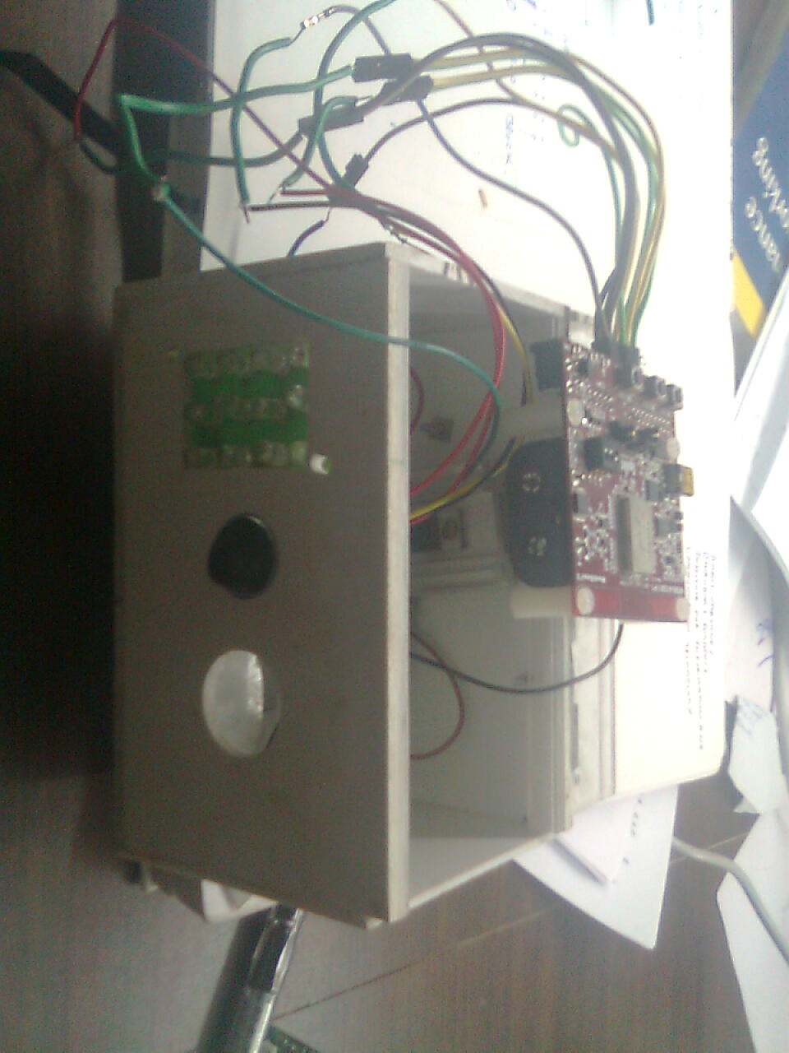
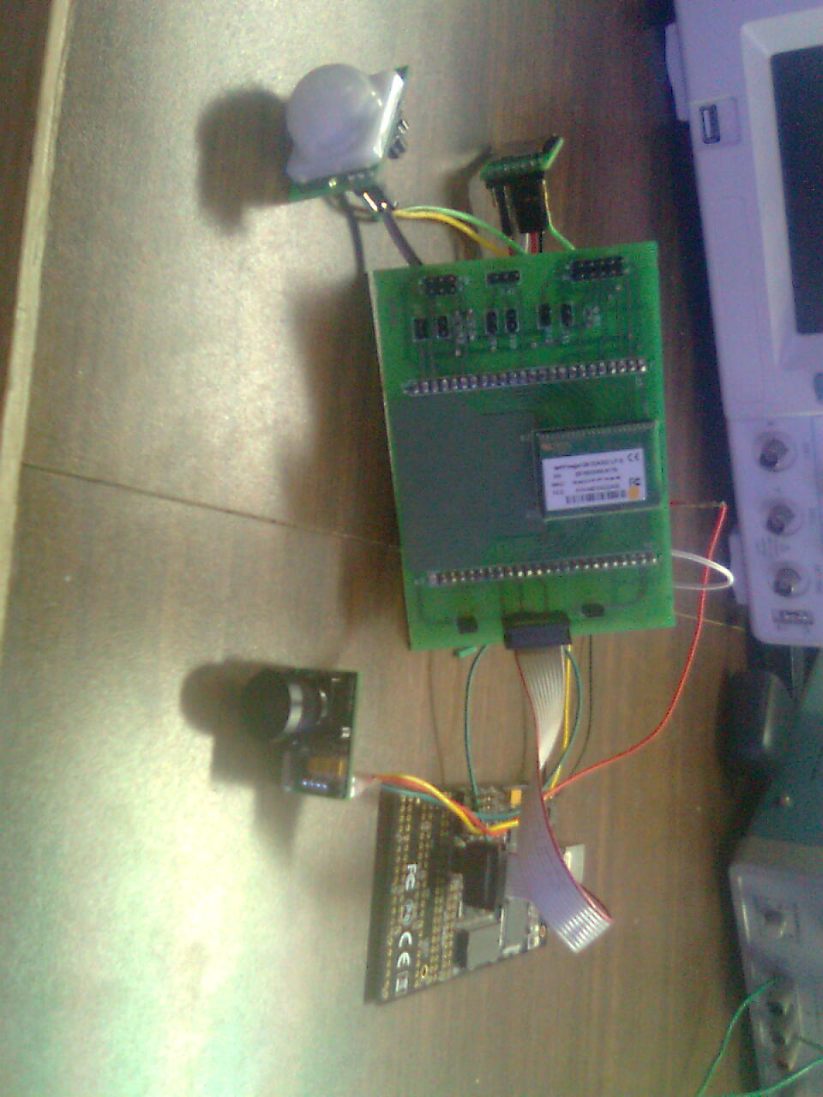
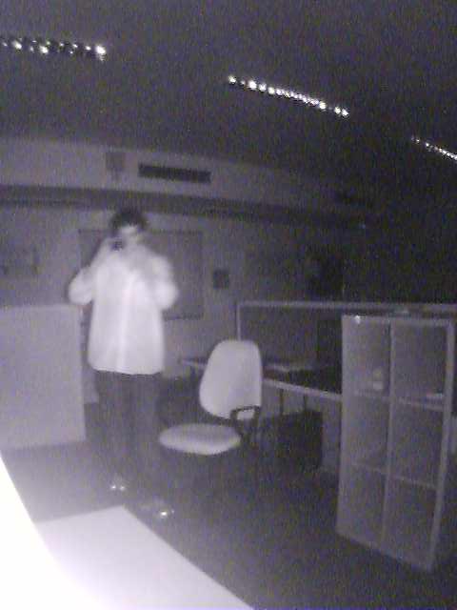
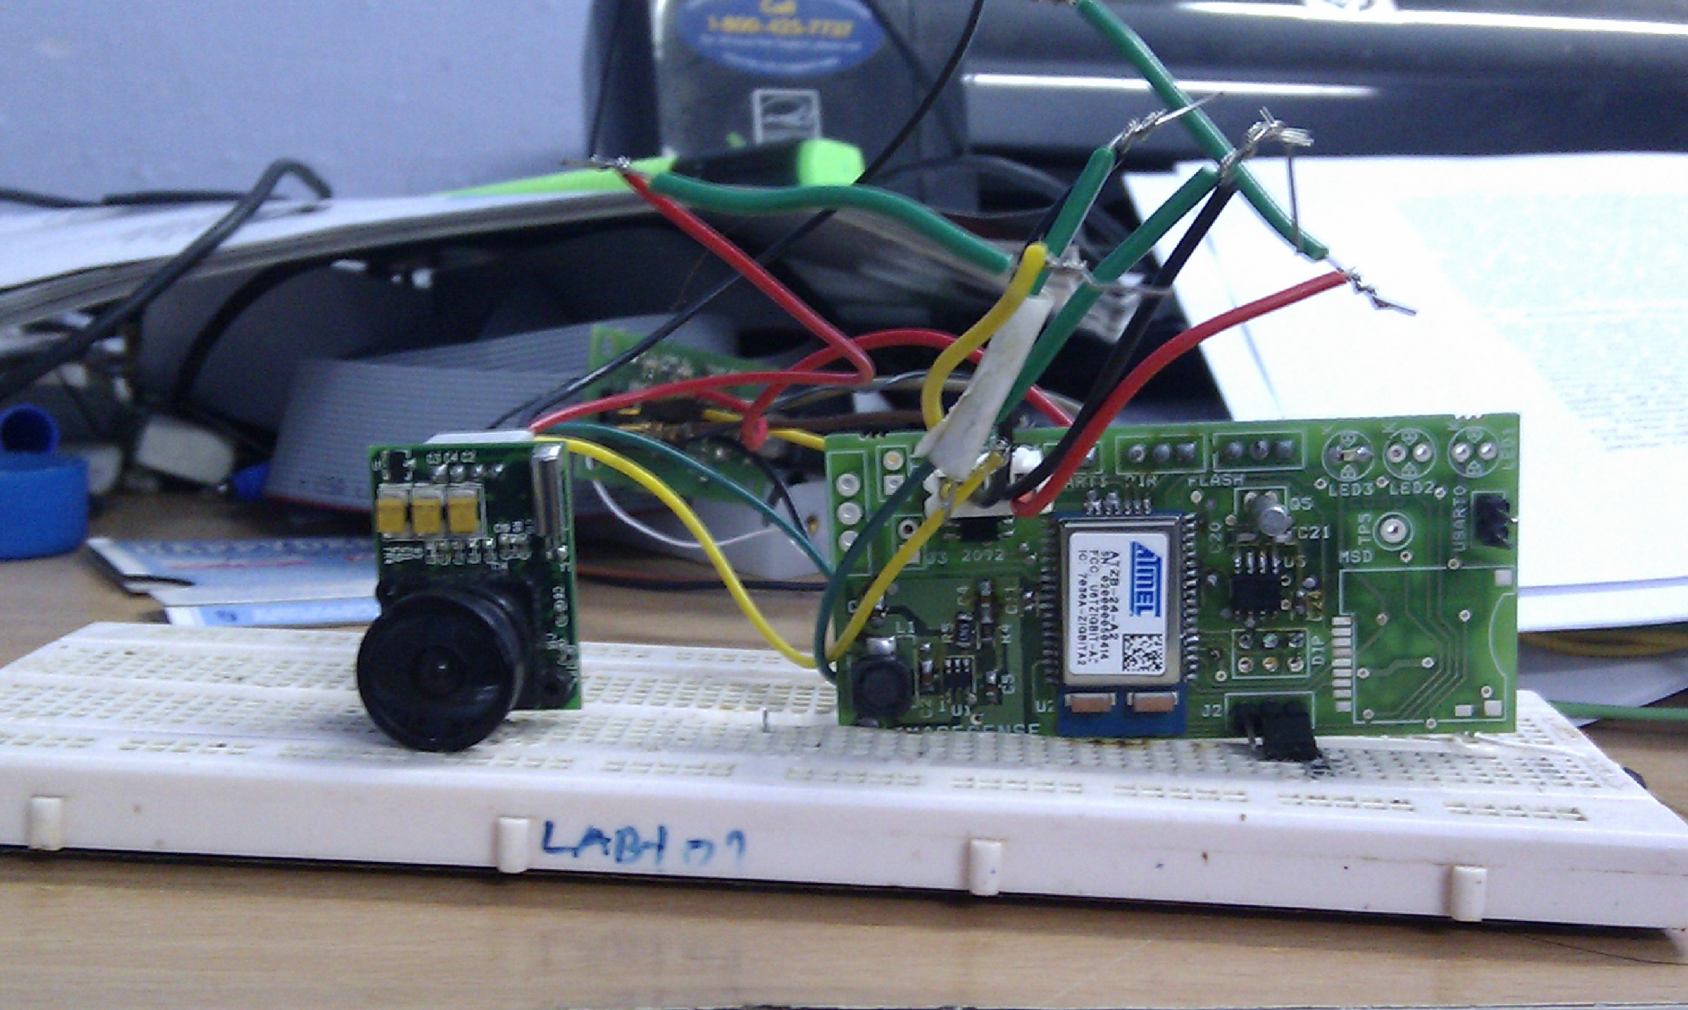
Get to know the instructor
Born in India, undergraduate studies in India (2007 - 2011)
Developed an interest in wireless embedded systems (2010)
One of major project: A wireless camera that takes images of tigers
Version 0.1 (Meshnetics)
Version 0.2 (ZigBit)
Version 0.3 (RFA1, Contiki OS)
Image taken under infrared flash
Notes:
++ We may all have heard of the term Internet of Things. So how are these wireless embedded systems related to the Internet of Things: Today, IoT includes a broad class of devices, including powerful platforms such as smartphones. However, it also includes more resource-constrained devices and what we call Wireless Embedded Systems, and in fact, I consider it to be one of the essential parts of the IoT ecosystem.
++ These are platforms equipped with a radio transceiver, sensor, microcontroller, and some form of energy storage. These platforms also often form a network, and sensor network as it is called has been an active area of research for the past two decades.
++ The research community has also developed wireless embedded platforms which we may know about, and these include: CMUCAM, which is an image sensor platform developed at Carnegie Mellon University, or Permamote is long life sensor platform from the lab I am associated with at UC Berkeley or Lorea which is a long-range backscatter platform that I had developed as part of my doctoral dissertation at Uppsala University. All of these are an example of Wireless Embedded Systems.

Slide 4
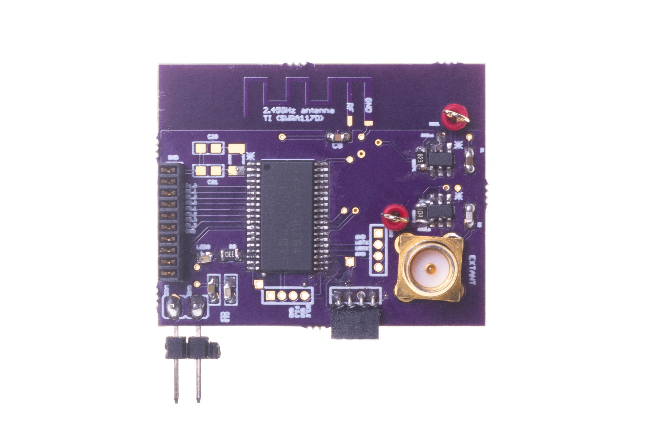
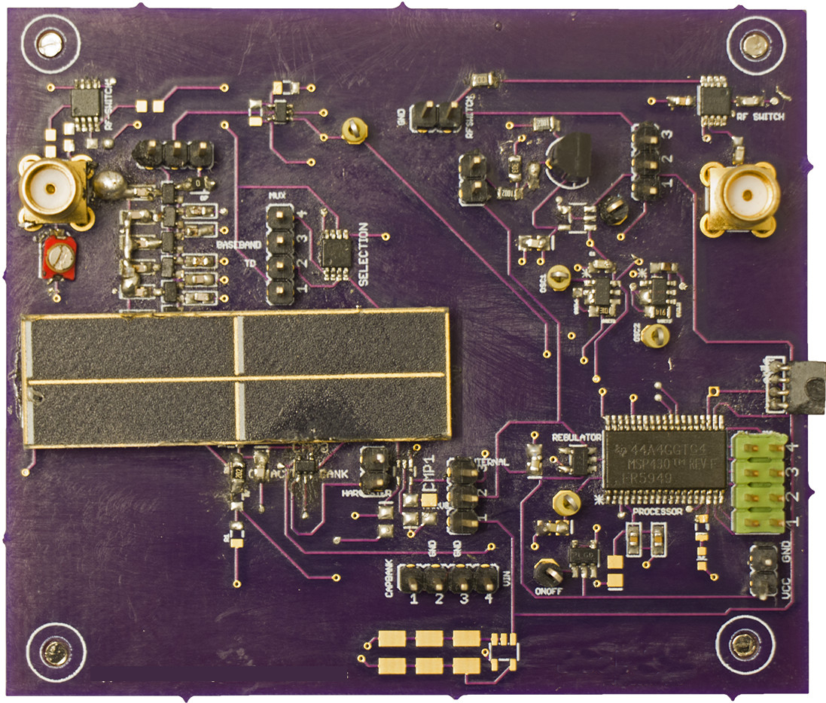
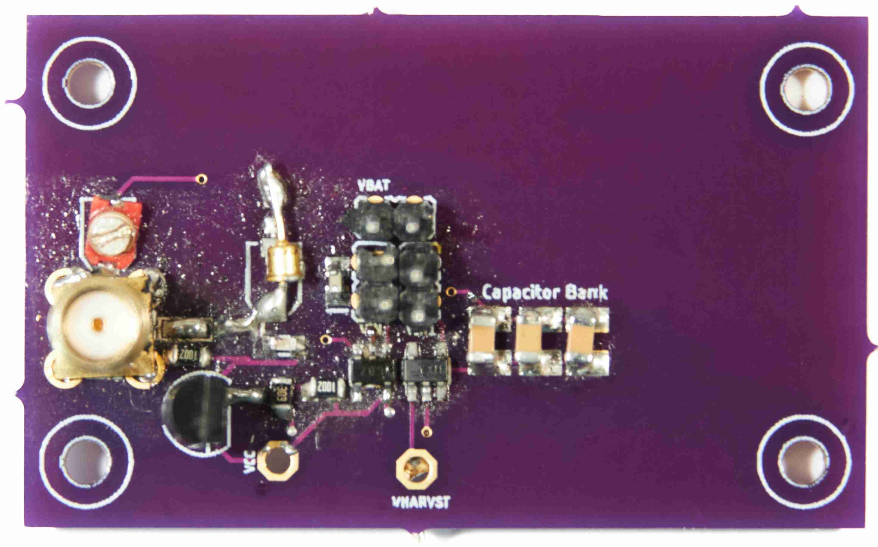
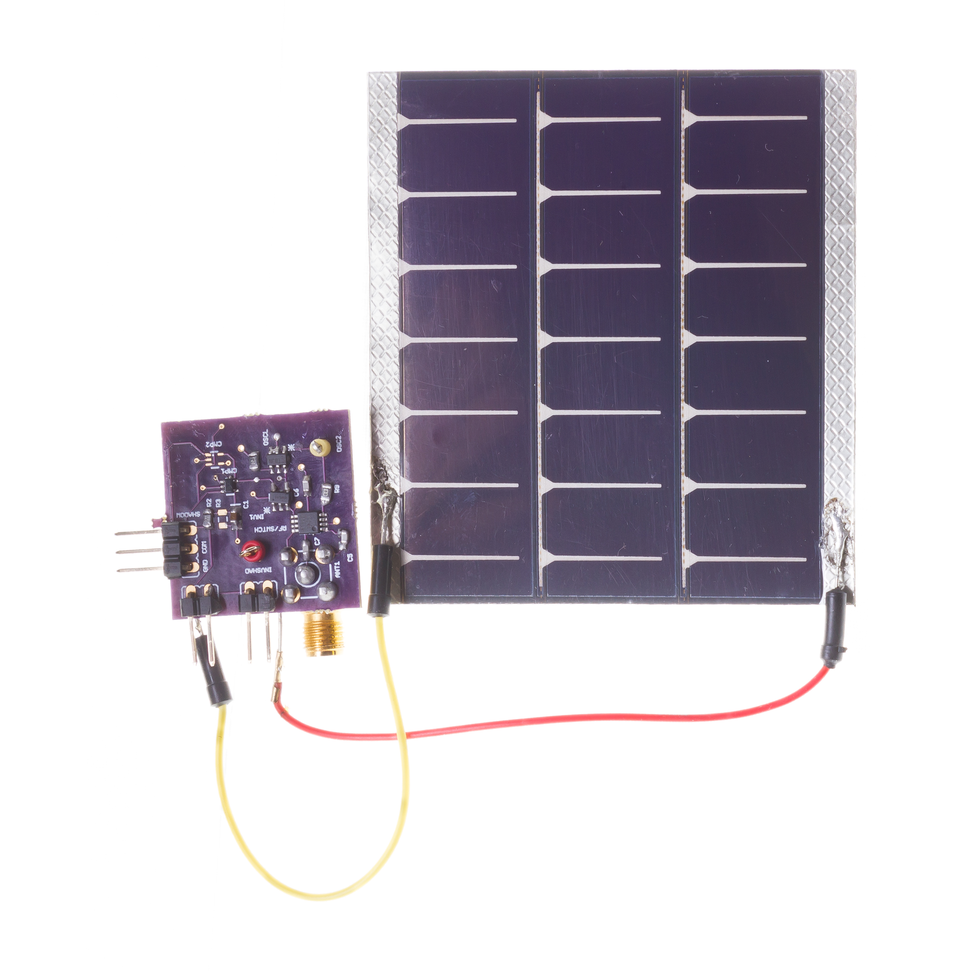
Get to know the instructor
Build real systems. Functional prototypes.
Commonly, my work involves working at the intersection of computer science, electrical engineering and communication
Highly collaborative: Authors from three different continents, different areas
[ACM SENSYS 2017]
[ACM MOBISYS 2020]
[ACM MOBICOM 2020]
[ACM VLCS 2017]
Notes:
++ We may all have heard of the term Internet of Things. So how are these wireless embedded systems related to the Internet of Things: Today, IoT includes a broad class of devices, including powerful platforms such as smartphones. However, it also includes more resource-constrained devices and what we call Wireless Embedded Systems, and in fact, I consider it to be one of the essential parts of the IoT ecosystem.
++ These are platforms equipped with a radio transceiver, sensor, microcontroller, and some form of energy storage. These platforms also often form a network, and sensor network as it is called has been an active area of research for the past two decades.
++ The research community has also developed wireless embedded platforms which we may know about, and these include: CMUCAM, which is an image sensor platform developed at Carnegie Mellon University, or Permamote is long life sensor platform from the lab I am associated with at UC Berkeley or Lorea which is a long-range backscatter platform that I had developed as part of my doctoral dissertation at Uppsala University. All of these are an example of Wireless Embedded Systems.

Slide 5
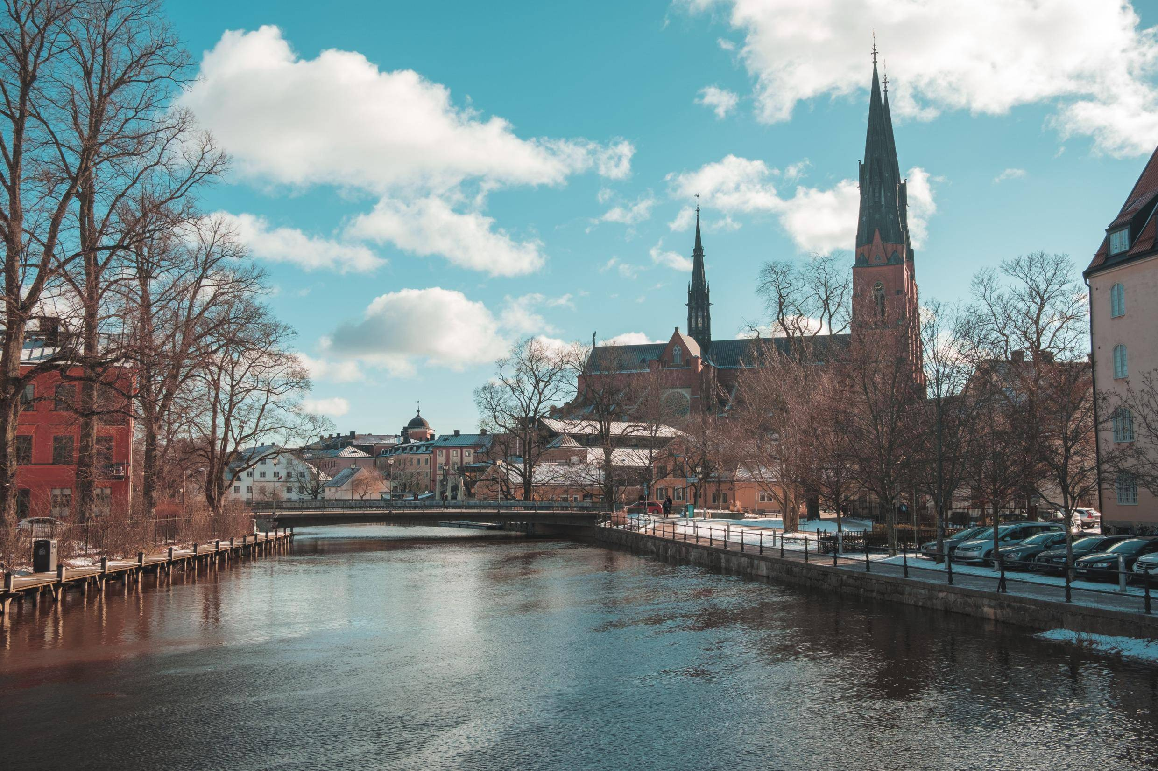
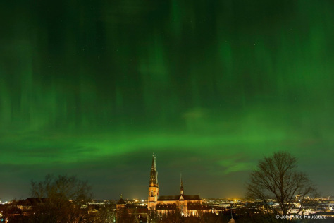
Get to know the instructor
Doctoral studies conducted in Sweden. PhD from Uppsala University
Dissertation: Enabling sustainable networked embedded systems
Notes:
++ We may all have heard of the term Internet of Things. So how are these wireless embedded systems related to the Internet of Things: Today, IoT includes a broad class of devices, including powerful platforms such as smartphones. However, it also includes more resource-constrained devices and what we call Wireless Embedded Systems, and in fact, I consider it to be one of the essential parts of the IoT ecosystem.
++ These are platforms equipped with a radio transceiver, sensor, microcontroller, and some form of energy storage. These platforms also often form a network, and sensor network as it is called has been an active area of research for the past two decades.
++ The research community has also developed wireless embedded platforms which we may know about, and these include: CMUCAM, which is an image sensor platform developed at Carnegie Mellon University, or Permamote is long life sensor platform from the lab I am associated with at UC Berkeley or Lorea which is a long-range backscatter platform that I had developed as part of my doctoral dissertation at Uppsala University. All of these are an example of Wireless Embedded Systems.

Slide 6
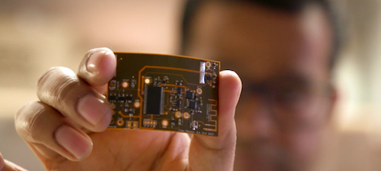


Get to know the instructor
Doctoral dissertation awarded 2019 ABB Research Award
Postdoctoral studies supported by 2019 ABB Award: UC Berkeley
Notes:
++ We may all have heard of the term Internet of Things. So how are these wireless embedded systems related to the Internet of Things: Today, IoT includes a broad class of devices, including powerful platforms such as smartphones. However, it also includes more resource-constrained devices and what we call Wireless Embedded Systems, and in fact, I consider it to be one of the essential parts of the IoT ecosystem.
++ These are platforms equipped with a radio transceiver, sensor, microcontroller, and some form of energy storage. These platforms also often form a network, and sensor network as it is called has been an active area of research for the past two decades.
++ The research community has also developed wireless embedded platforms which we may know about, and these include: CMUCAM, which is an image sensor platform developed at Carnegie Mellon University, or Permamote is long life sensor platform from the lab I am associated with at UC Berkeley or Lorea which is a long-range backscatter platform that I had developed as part of my doctoral dissertation at Uppsala University. All of these are an example of Wireless Embedded Systems.

Slide 7
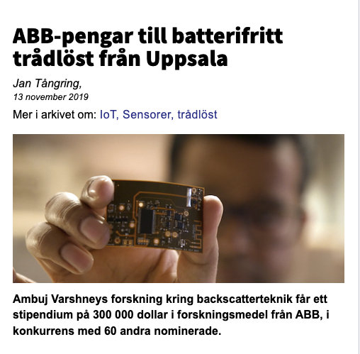
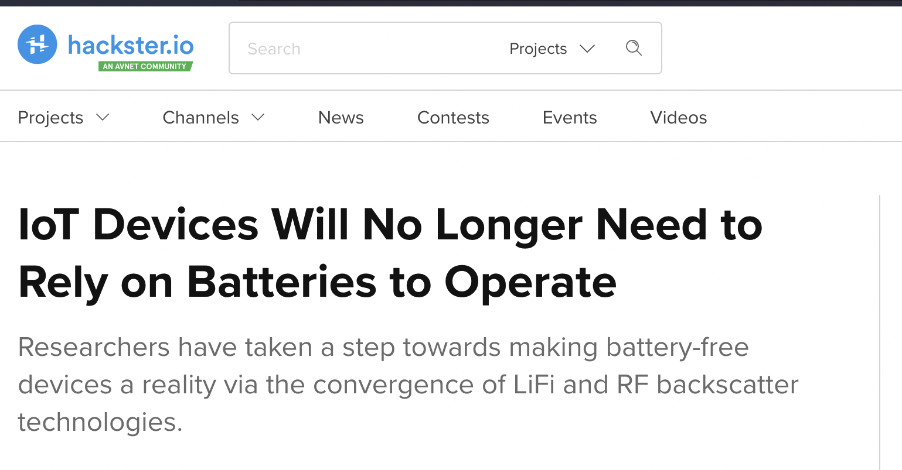

Wireless, Embedded Intelligence, Sensing and Emerging Technologies (WEISER) Group
Aim: World leading research in the area of wireless embedded systems
Regularly publish research findings in flagship venues of the area;
ACM MobiCom, MobiSys, SenSys, Ipsn, HotNets, Getmobile and others
Research findings and awards are regularly covered by major media outlets
Notes:
++ We may all have heard of the term Internet of Things. So how are these wireless embedded systems related to the Internet of Things: Today, IoT includes a broad class of devices, including powerful platforms such as smartphones. However, it also includes more resource-constrained devices and what we call Wireless Embedded Systems, and in fact, I consider it to be one of the essential parts of the IoT ecosystem.
++ These are platforms equipped with a radio transceiver, sensor, microcontroller, and some form of energy storage. These platforms also often form a network, and sensor network as it is called has been an active area of research for the past two decades.
++ The research community has also developed wireless embedded platforms which we may know about, and these include: CMUCAM, which is an image sensor platform developed at Carnegie Mellon University, or Permamote is long life sensor platform from the lab I am associated with at UC Berkeley or Lorea which is a long-range backscatter platform that I had developed as part of my doctoral dissertation at Uppsala University. All of these are an example of Wireless Embedded Systems.

Slide 8
Do you know what the Internet of Things is? How does Internet of Things impact you?
Notes:
++ Over the past few years, I have designed several backscatter and beyond backscatter systems that precisely overcome these critical challenges that have limited the widespread deployment of backscatter on IoT devices.
++ The research vision that I have pursued and would like to pursue as a faculty member is to enable a massive deployment of IoT devices by bridging the energy asymmetry between sensing, computation and communication blocks by designing novel platforms and communication mechanisms. I am going to describe some of my research contributions next.

Slide 9
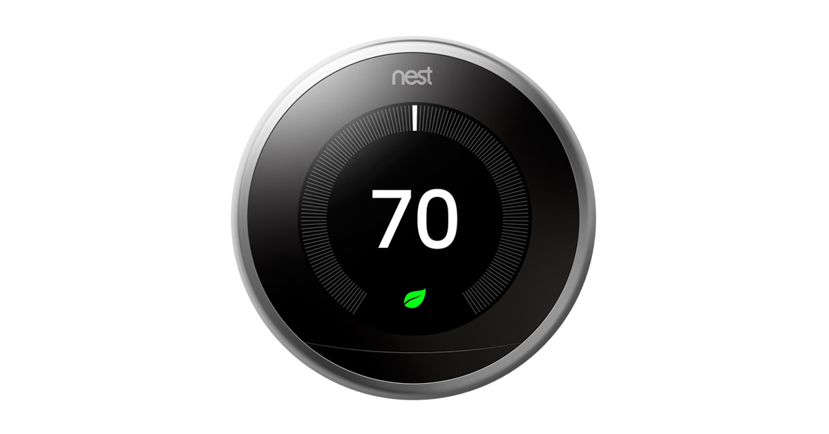
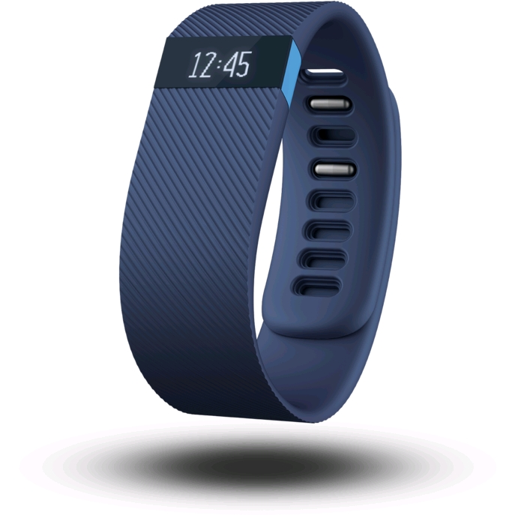
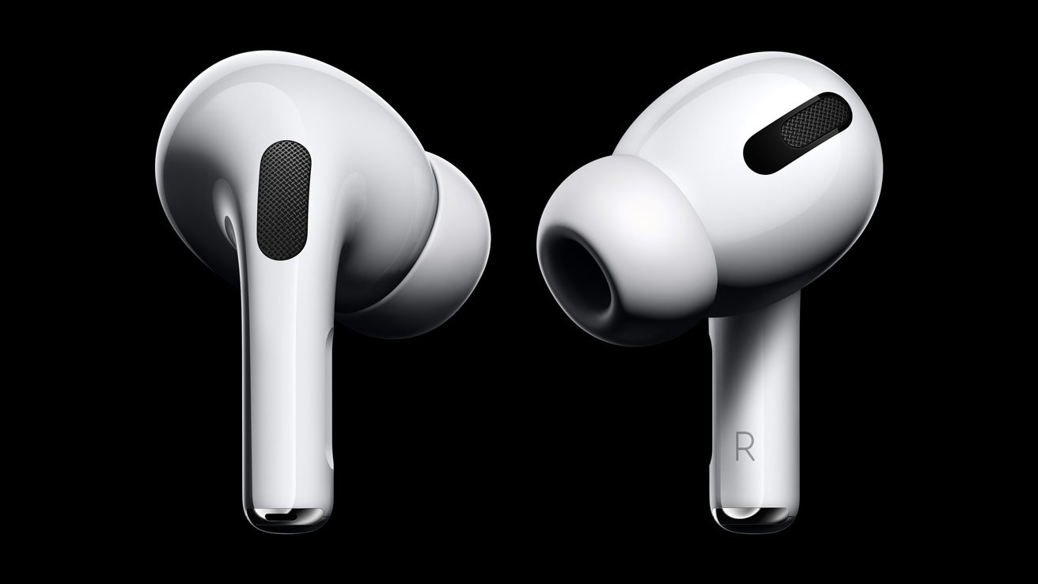
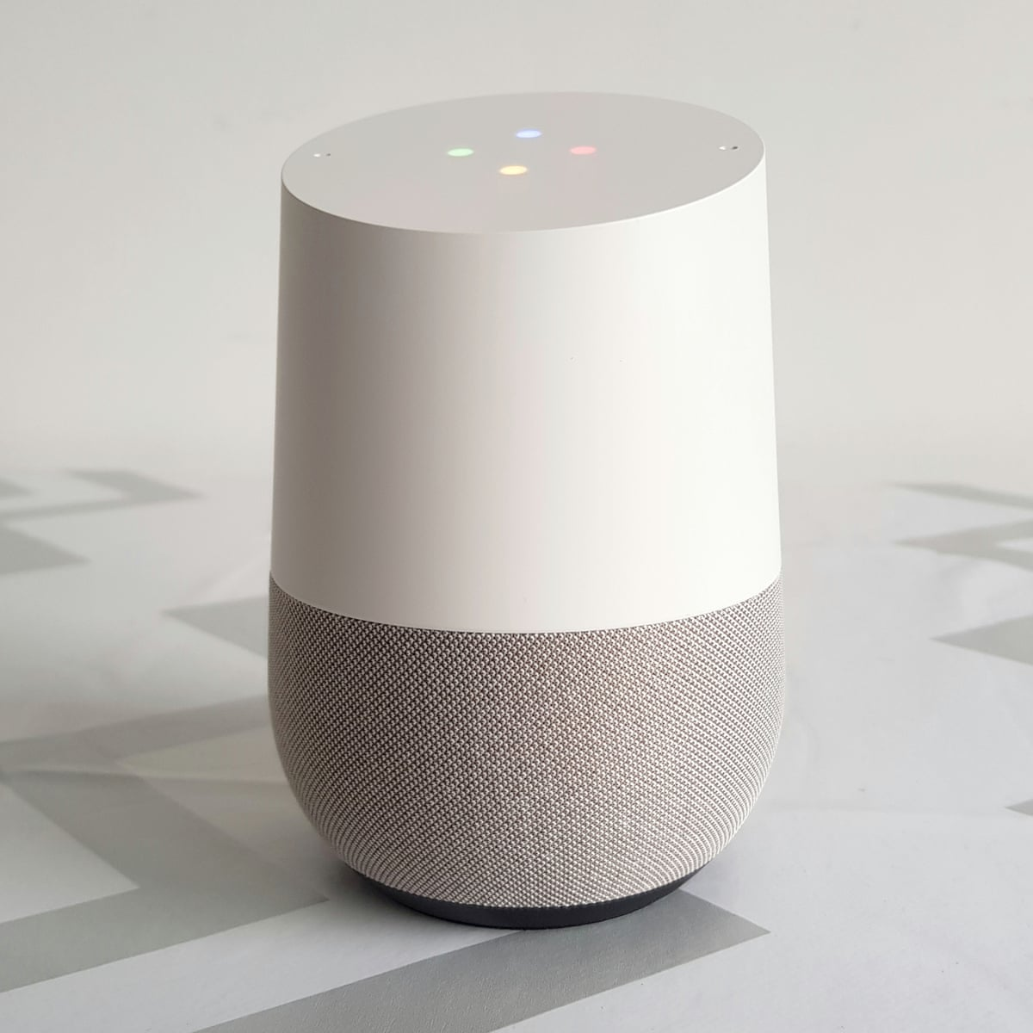
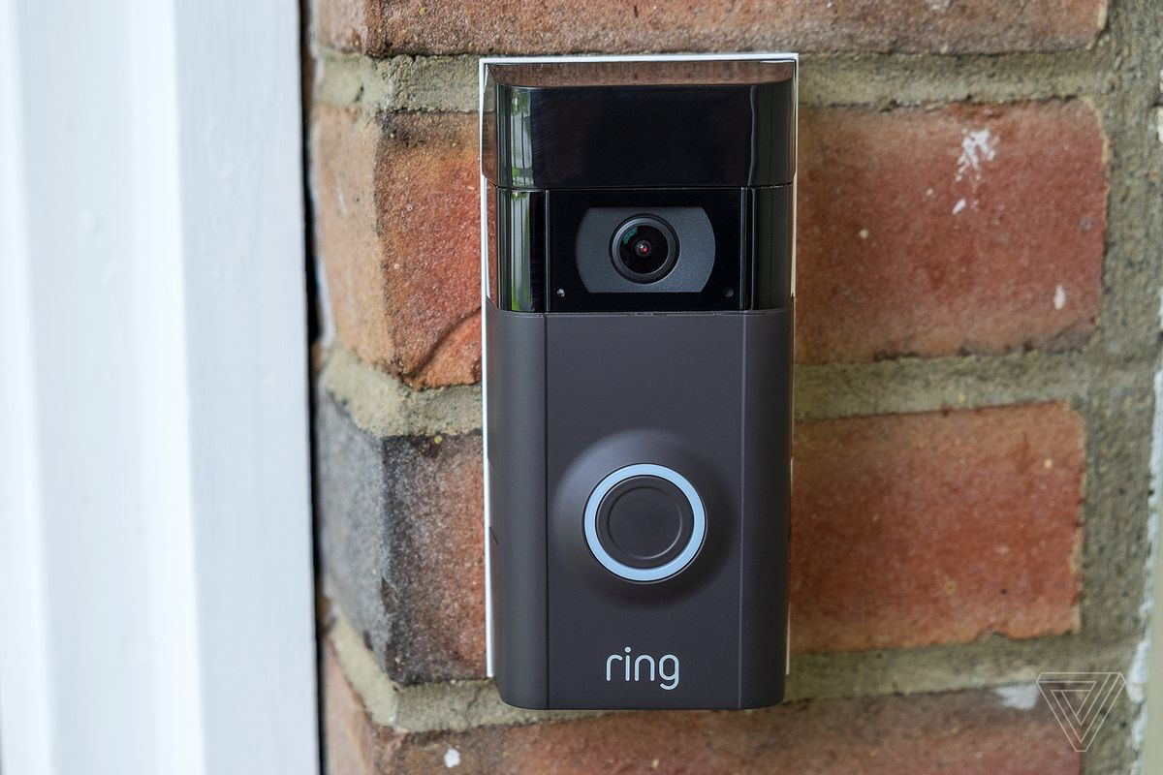
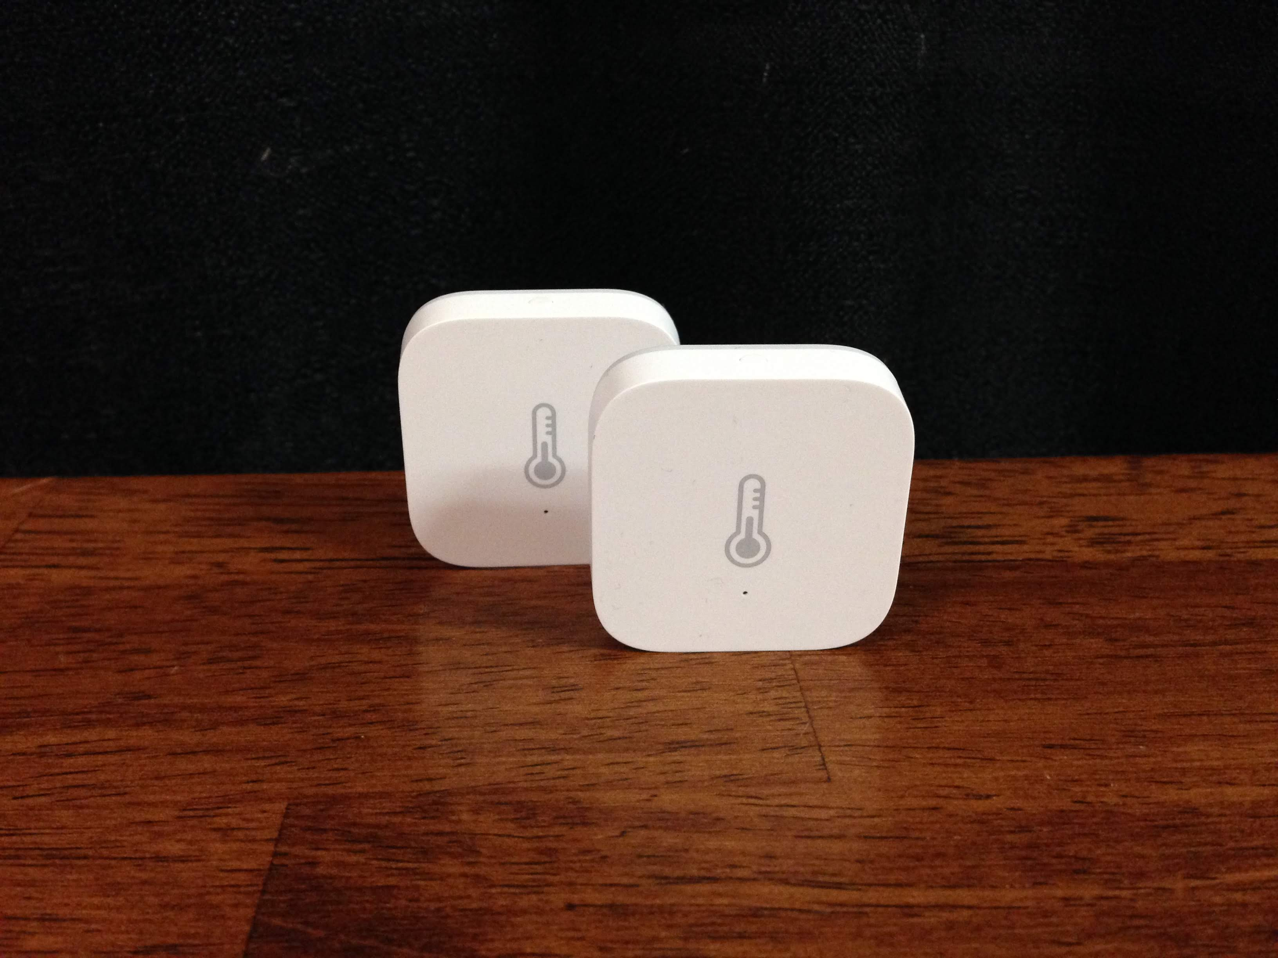
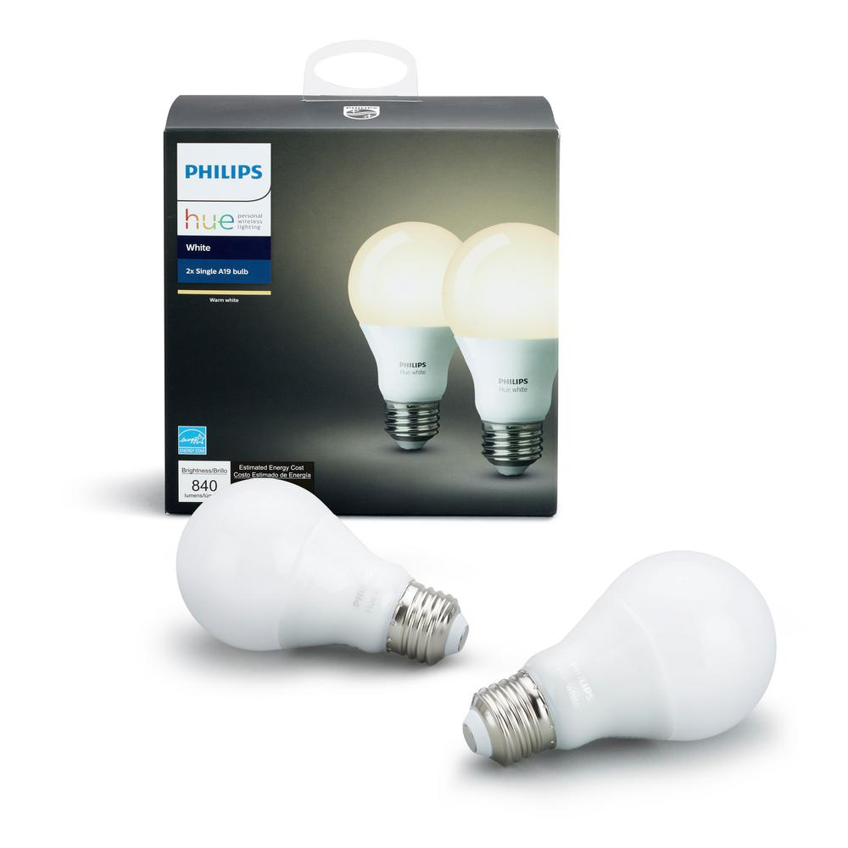
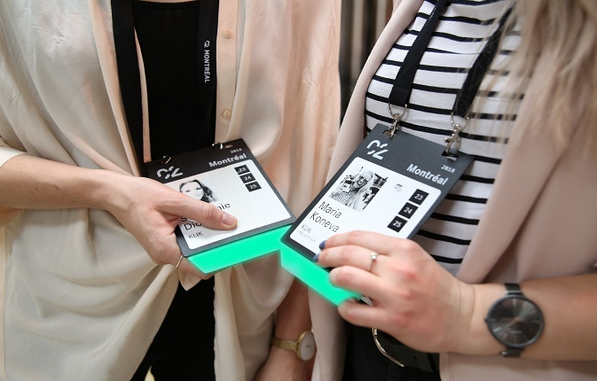
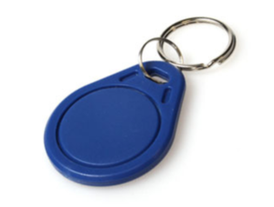
Internet of things devices are all around us...
Google nest thermostat
Fitbit activity tracker
Apple airpods
Smart speaker
Ring doorbell
Xiaomi temperature sensor
Philips hue smart bulb
Smart badges
BLE proximity beacon
Notes:
+ I begin this presentation by demonstrating devices that we interact with within our daily lives. These include Fitbit, AirPods, smart speakers or ble proximity beacons that we attach to objects such as keychain to keep track of them. All of these are examples of wireless embedded systems.

Slide 10
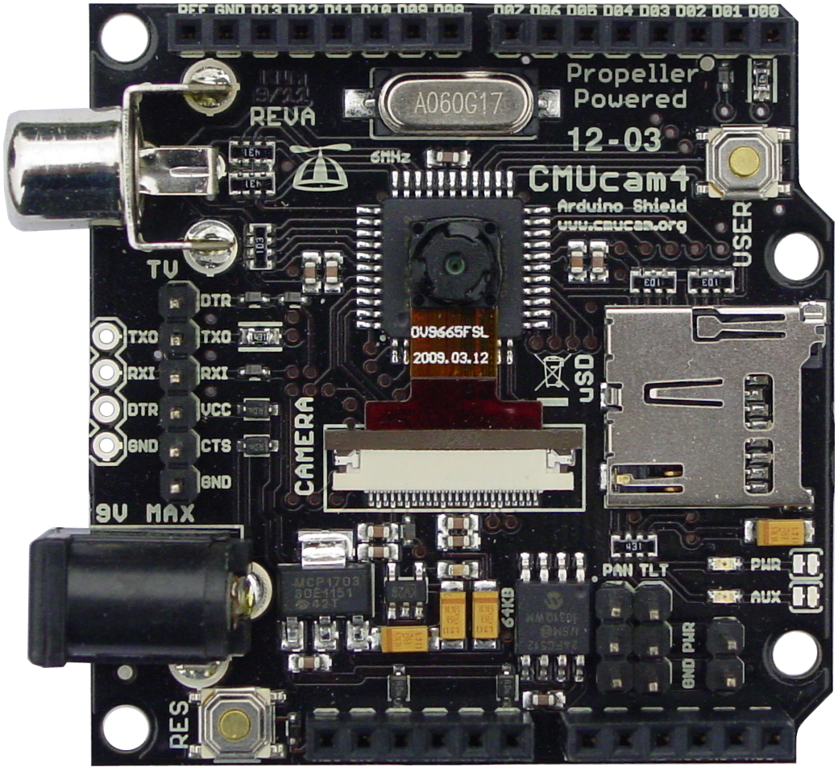
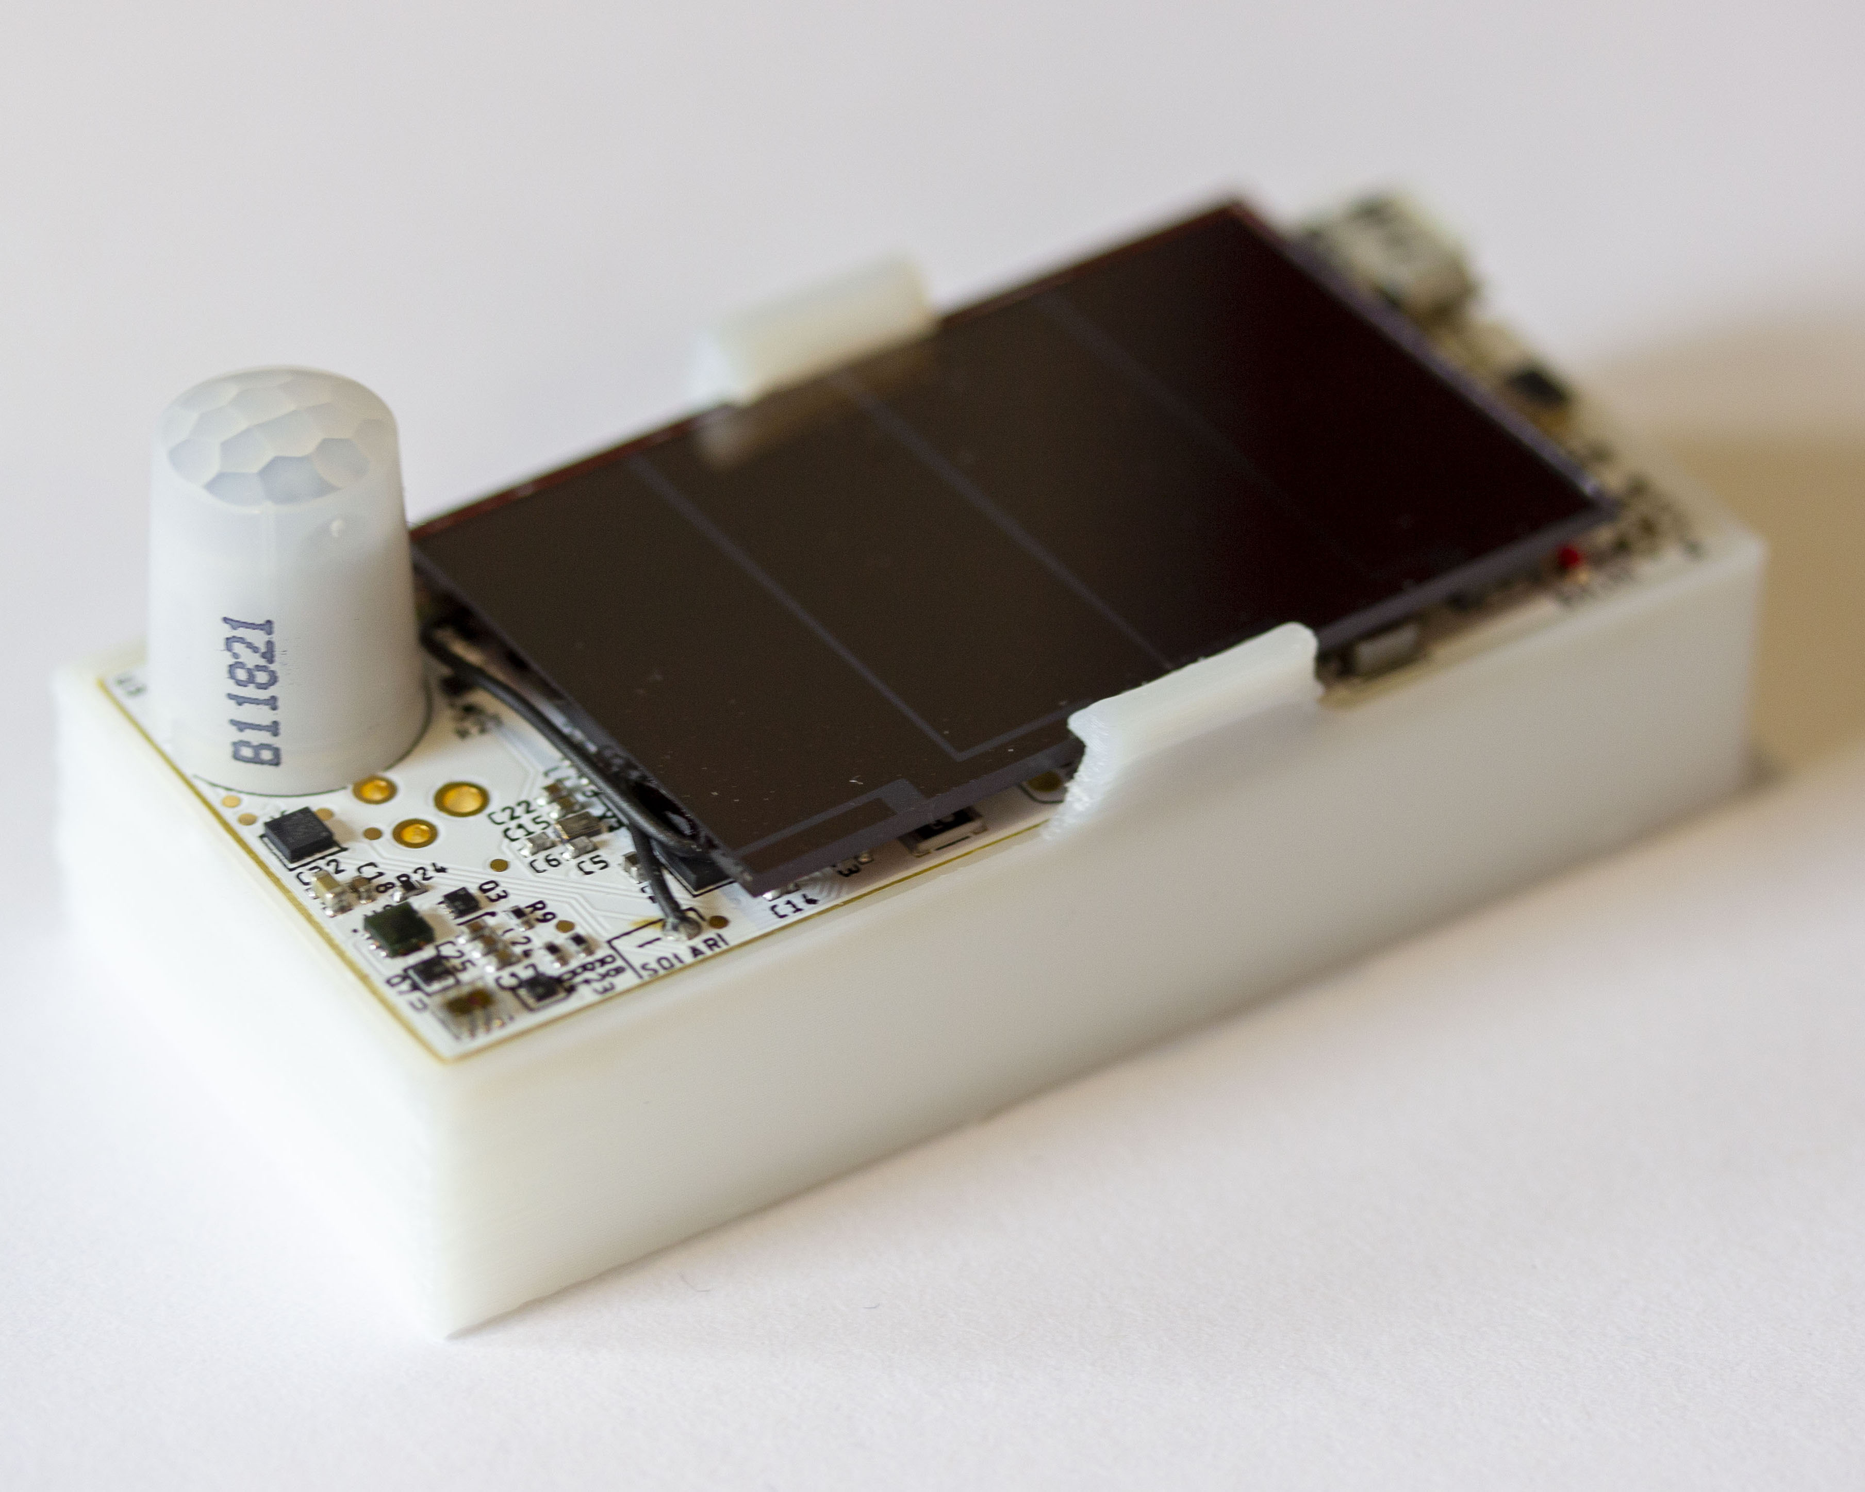
Internet of things and wireless embedded systems
Wireless embedded systems (WES) are platforms equipped with radio transceiver, sensors, microcontroller and some form of energy storage
WES are an important part of the internet of things (IoT) ecosystem
CMUCam
[Carnegie Mellon University]
Permamote
[University of California, Berkeley]
LoRea
[Uppsala University]
Notes:
++ We may all have heard of the term Internet of Things. So how are these wireless embedded systems related to the Internet of Things: Today, IoT includes a broad class of devices, including powerful platforms such as smartphones. However, it also includes more resource-constrained devices and what we call Wireless Embedded Systems, and in fact, I consider it to be one of the essential parts of the IoT ecosystem.
++ These are platforms equipped with a radio transceiver, sensor, microcontroller, and some form of energy storage. These platforms also often form a network, and sensor network as it is called has been an active area of research for the past two decades.
++ The research community has also developed wireless embedded platforms which we may know about, and these include: CMUCAM, which is an image sensor platform developed at Carnegie Mellon University, or Permamote is long life sensor platform from the lab I am associated with at UC Berkeley or Lorea which is a long-range backscatter platform that I had developed as part of my doctoral dissertation at Uppsala University. All of these are an example of Wireless Embedded Systems.

Slide 11
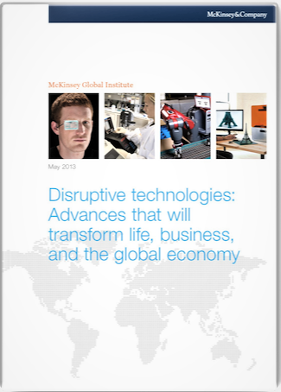
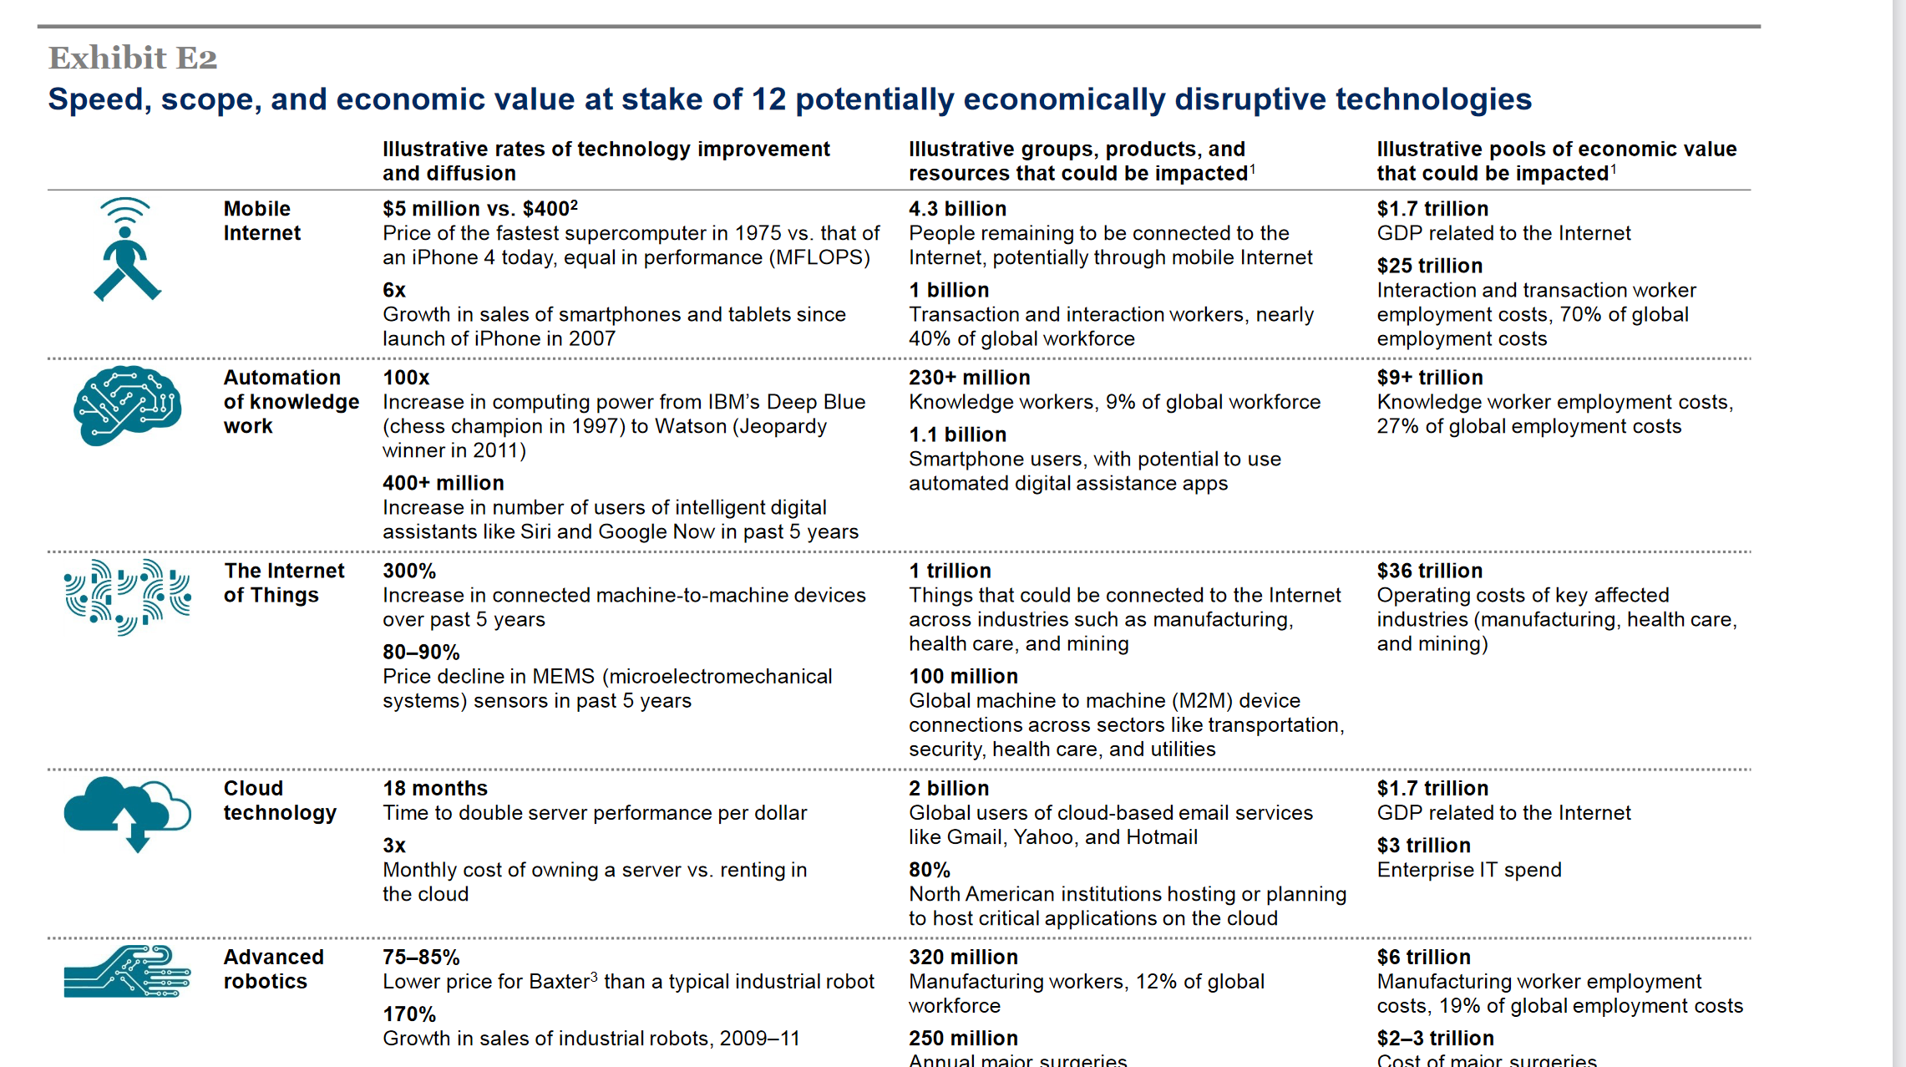
Internet of things will be bigger than cloud computing
Disruptive technologies: Advances that will transform life, business, and the global economy - McKinsey Global Institute (2013)
Notes:
So how big would the Internet of Things be?
We investigate a report from McKinsey called Disruptive Technologies which claims that the IoT would influence the combined economic value well over 36 trillion, far higher than cloud technology. Hence, this rapid growth in the IoT that we are witnessing is placing us on a pathway towards eclipsing (in economic value) major trends from previous decades, such as the cloud computing.

Slide 12
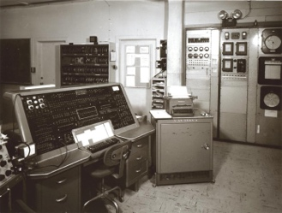
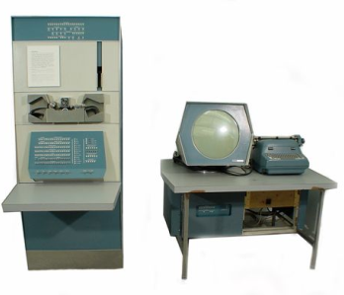
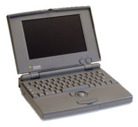
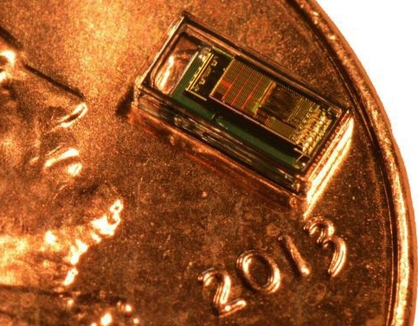
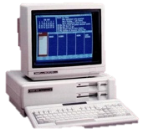

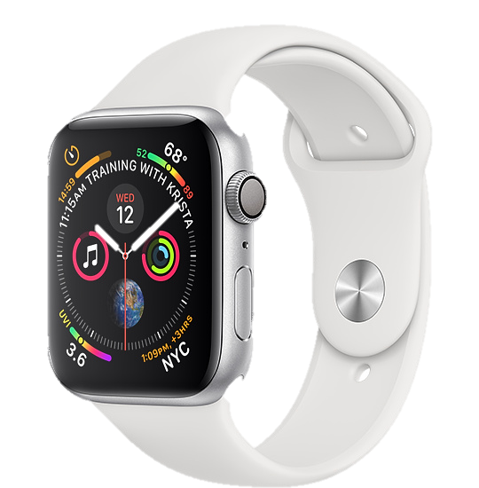
Trillion embedded devices will be deployed soon
Mainframe
“Roughly every decade a new, lower priced computer class forms based on a new programming platform, network, and interface resulting in new usage and the establishment of a new industry.”
1 per Enterprise
Workstation
1 per Engineer
[Bell et al. Computer, 1972, ACM, 2008]
Smart Dust
Laptop
100 – 1000’s per person
log (people per computer)
1 per Professional
IoT/Wearable
Mini Computer
10’s per person
1 per Company
Personal Computer
1 per Family
Smartphone
1 per person

Slide 13
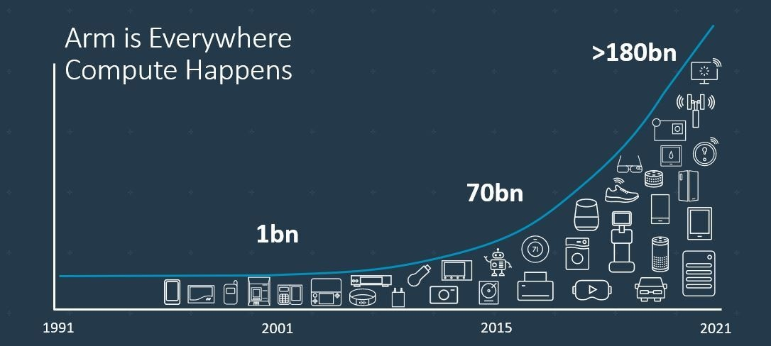
Trillion embedded devices will be deployed soon
Fourth quarter of 2020. Arm shipped 4.4 billion Cortex-M processors
ARM Press Release (Feb 11, 2021) reporting on Fourth Quarter 2020
Notes:
++ Due to the numerous applications that the internet of things enables, we are witnessing a massive growth in the number of microcontrollers being sold. These microcontrollers form the heart of the IoT platforms.
++ To illustrate this point: ARM, a popular UK based company, just reported numbers, and in these numbers, they state that they sold 4.4 billion cortex M processors in just one quarter. These microcontrollers are almost exclusively used on IoT platforms, which demonstrates the massive growth we are witnessing in the number of deployed IoT devices.
++ If this growth continues, and in fact, I believe this growth will accelerate, we will soon have a trillion embedded devices that are going to be deployed in the world.

Slide 14
However, this rapid growth may stop!
Notes:
++ Over the past few years, I have designed several backscatter and beyond backscatter systems that precisely overcome these critical challenges that have limited the widespread deployment of backscatter on IoT devices.
++ The research vision that I have pursued and would like to pursue as a faculty member is to enable a massive deployment of IoT devices by bridging the energy asymmetry between sensing, computation and communication blocks by designing novel platforms and communication mechanisms. I am going to describe some of my research contributions next.

Slide 15
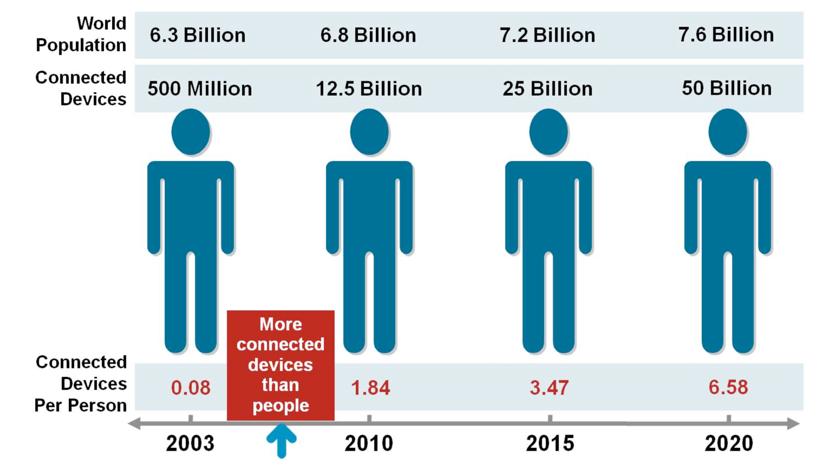
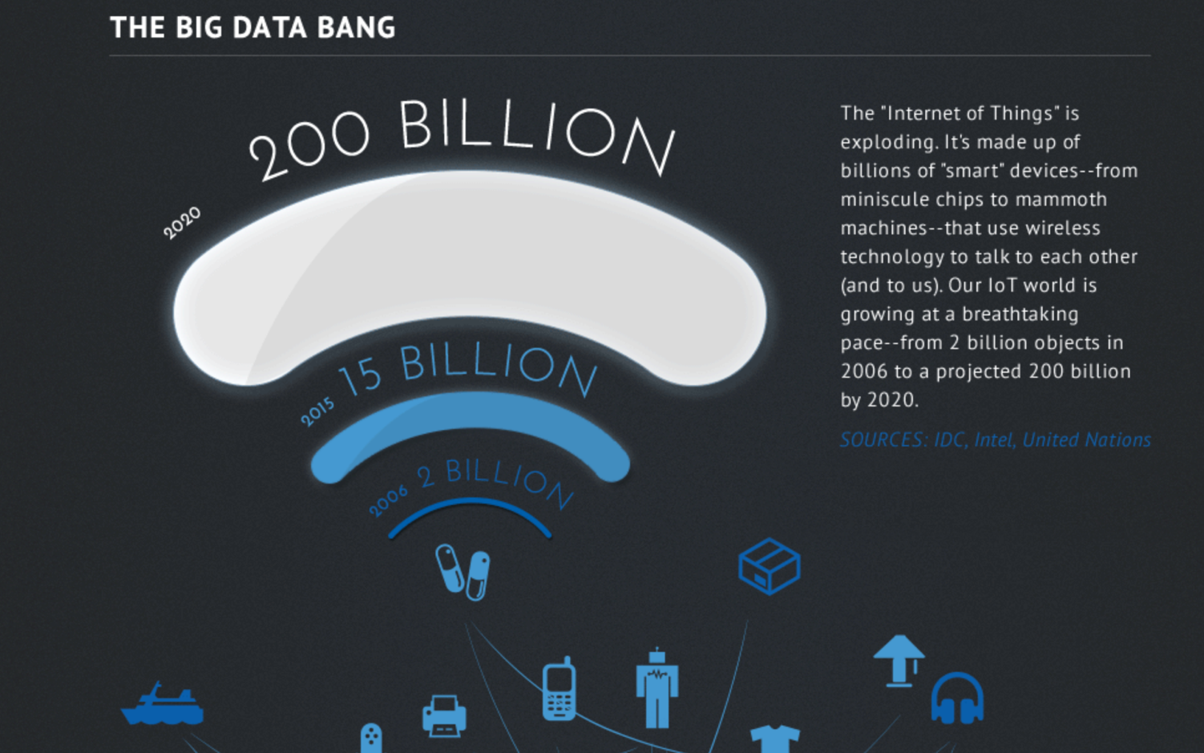
Let's go back to predictions about scale of IoT
Courtesy: CISCO
Courtesy: Intel
Notes:
So how big would the Internet of Things be?
We investigate a report from McKinsey called Disruptive Technologies which claims that the IoT would influence the combined economic value well over 36 trillion, far higher than cloud technology. Hence, this rapid growth in the IoT that we are witnessing is placing us on a pathway towards eclipsing (in economic value) major trends from previous decades, such as the cloud computing.

Slide 16
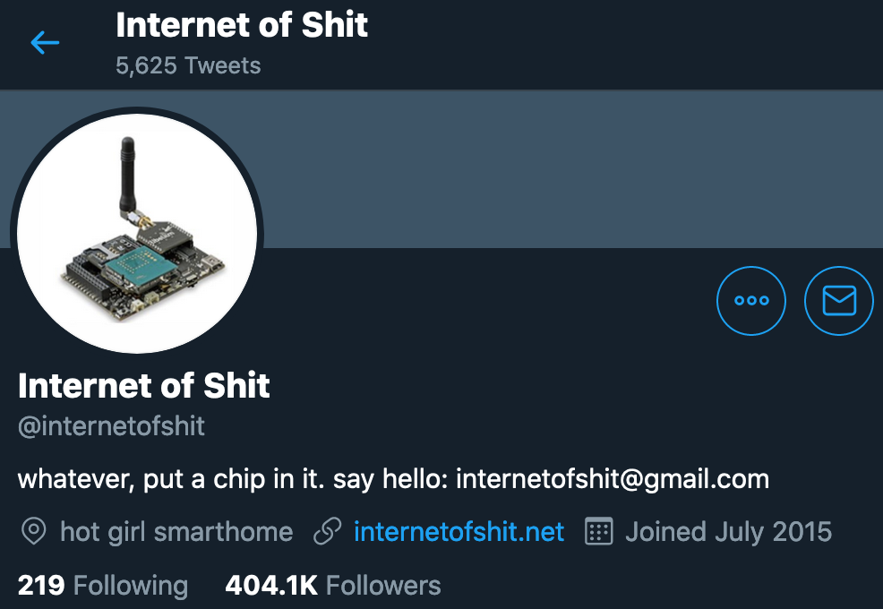
Word of caution: Mind the hype

Slide 17
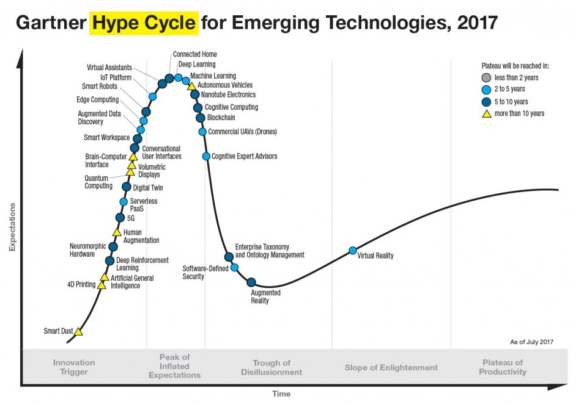
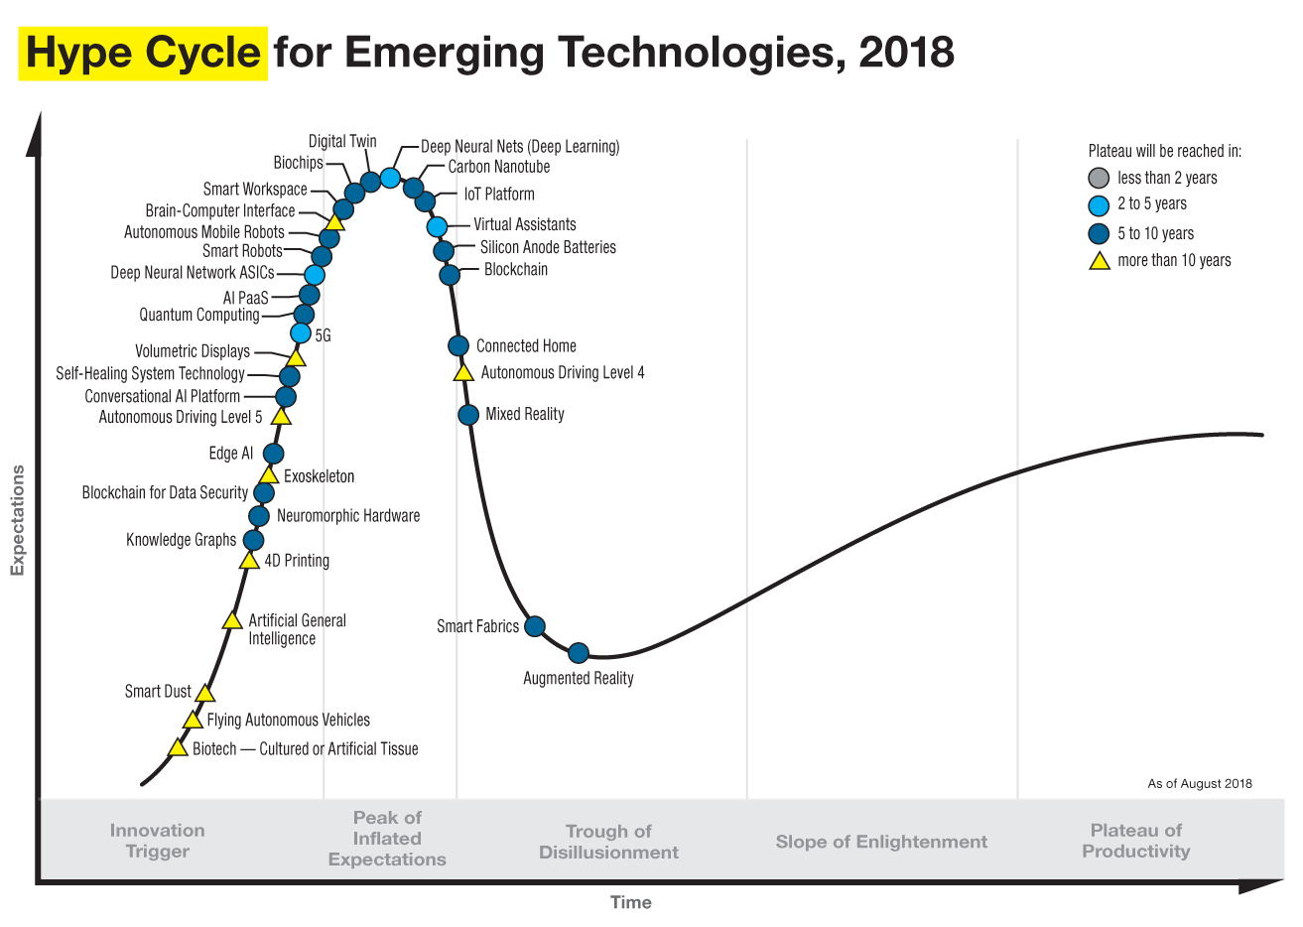
Word of caution: Mind the hype

Slide 18
Internet of things has an energy challenge
Notes:
++ Over the past few years, I have designed several backscatter and beyond backscatter systems that precisely overcome these critical challenges that have limited the widespread deployment of backscatter on IoT devices.
++ The research vision that I have pursued and would like to pursue as a faculty member is to enable a massive deployment of IoT devices by bridging the energy asymmetry between sensing, computation and communication blocks by designing novel platforms and communication mechanisms. I am going to describe some of my research contributions next.

Slide 19
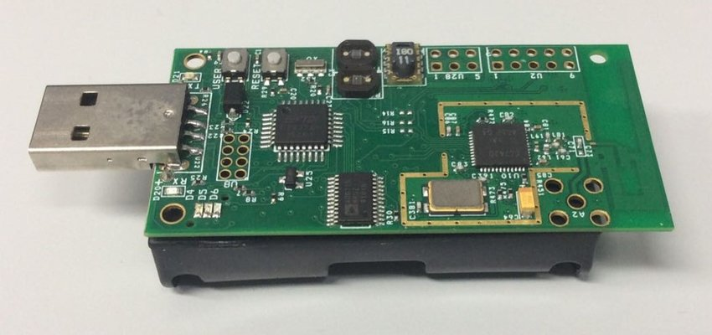
Wireless embedded systems has an energy challenge
Devices that comprise wireless embedded systems are energy expensive:
Operate on bulky batteries. Frequent replacement. Challenging at scale
Challenging to realize novel form factor for the platform (sticker)
Energy challenge is biggest hindrance to unlocking trillions of dollars economic value enabled through the massive deployment of IoT devices
TelOS B Sensor node (Powered by AA batteries)
Flexible backscatter tag based on LoRea (SENSYS 2017)
Notes:
++ While we are deploying an enormously large number of IoT devices, I claim that very little attention is being paid to their energy challenge.
++ Today, most IoT devices are very energy expensive, and consequently, they rely on bulky batteries such as AA/AAA sized batteries for their operation. Even when operating on these batteries, they require frequent replacement of the exhausted batteries. This can be challenging when performed at a massive scale, especially considering that we may have a trillion embedded device deployed in the world.
++ Further, it can also harm the environment. These batteries use toxic chemicals, which means now we can have billions of toxic chemicals laden batteries that would be disposed of in landfills. This is especially important as sustainability has become an essential aspect across the world; in fact, imperial college was celebrating sustainability week.

Slide 20
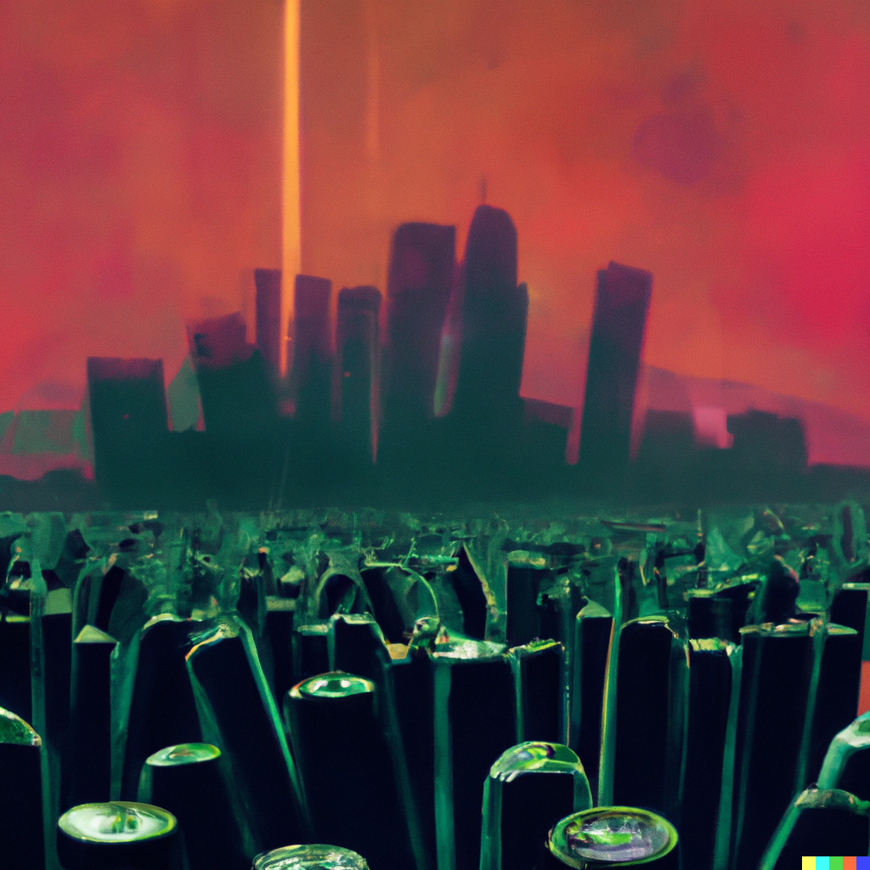
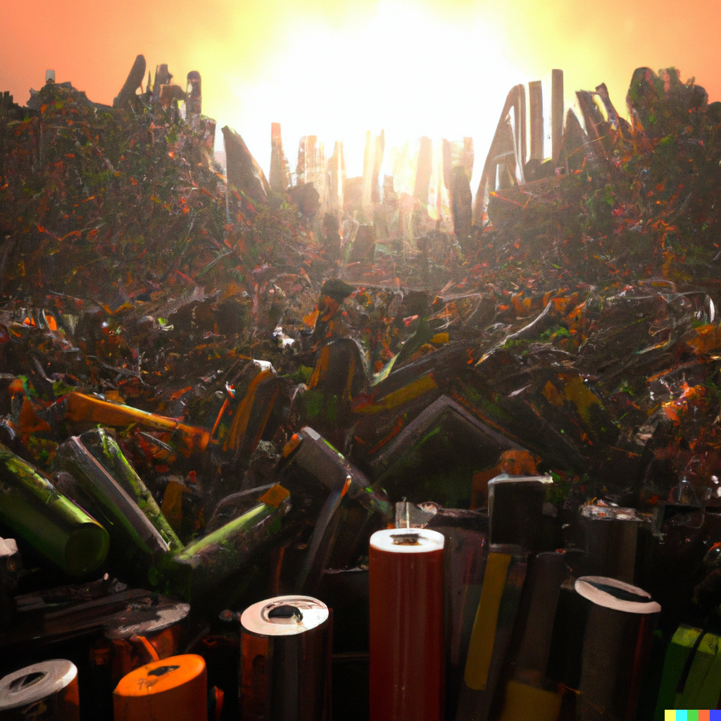
Wireless embedded systems has an energy challenge
Notes:
++ While we are deploying an enormously large number of IoT devices, I claim that very little attention is being paid to their energy challenge.
++ Today, most IoT devices are very energy expensive, and consequently, they rely on bulky batteries such as AA/AAA sized batteries for their operation. Even when operating on these batteries, they require frequent replacement of the exhausted batteries. This can be challenging when performed at a massive scale, especially considering that we may have a trillion embedded device deployed in the world.
++ Further, it can also harm the environment. These batteries use toxic chemicals, which means now we can have billions of toxic chemicals laden batteries that would be disposed of in landfills. This is especially important as sustainability has become an essential aspect across the world; in fact, imperial college was celebrating sustainability week.

Slide 21
Device architecture of Wireless Embedded Systems
Notes:
++ Over the past few years, I have designed several backscatter and beyond backscatter systems that precisely overcome these critical challenges that have limited the widespread deployment of backscatter on IoT devices.
++ The research vision that I have pursued and would like to pursue as a faculty member is to enable a massive deployment of IoT devices by bridging the energy asymmetry between sensing, computation and communication blocks by designing novel platforms and communication mechanisms. I am going to describe some of my research contributions next.

Slide 22
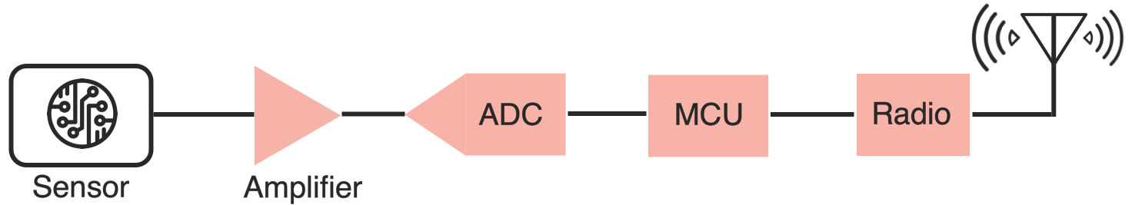
Wireless embedded devices architecture has remained unchanged over the past decades
During past decades, sensors have become exceedingly energy-efficient
E.g., Accelerometer, Temperature, Image Sensors: Few µW’s of power
Significant energy asymmetry exists between the sensors, computational elements and radio transceivers
Conventional and widely used architecture of embedded wireless platform
Notes:
Why do the IoT platforms suffer from this energy challenge? To understand this, we investigate the architecture of the IoT device. We show this architecture in the figure on the slide. It consists of a series of stages that enable us to sense physical phenomena, process and transmit the sensor information through a transceiver such as ZigBee/BLE/LoRa.
This architecture has remained unchanged over the past two decades. We find that during this time, sensors have become exceeding efficient. Today, we find sensors such as an accelerometer or a temperature sensor consumes just a few tens of microwatts of power consumption. However, we find that rest of the architecture components that are shown in red colour remain significantly energy expensive. To understand the reason for this significant energy asymmetry, we look at the following slide.

Slide 23
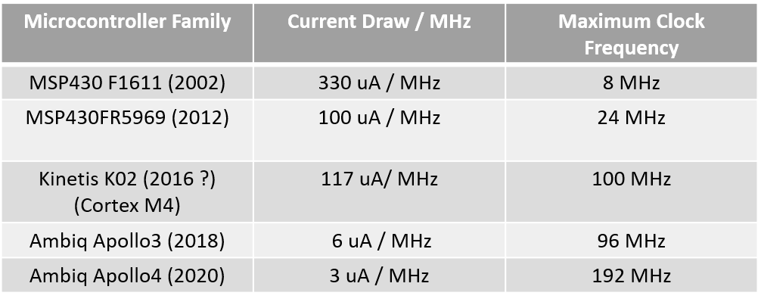
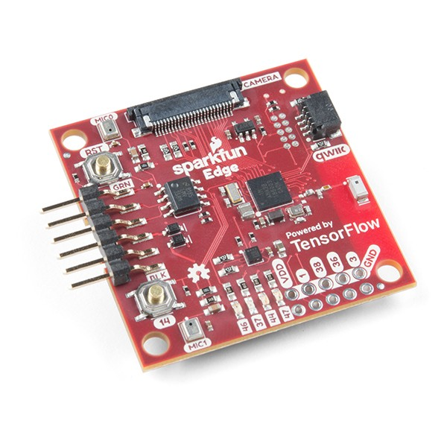
Computation is becoming energy inexpensive
Today, computation is at least an order of magnitude more energy expensive than performing a sensing operation
Digital components are becoming energy efficient (Moore’s law)
We can expect power consumption for computation to match sensing
Ambiq Apollo3
Notes:
First, we look at the computational elements, and these consist of a microcontroller or an FPGA. Today, we find that these computational elements consume at least one order of magnitude higher power consumption when compared to the commonly used sensors.
However, we also find that microcontrollers are increasingly becoming energy efficient. We investigate a typical microcontroller that has been used in sensor platforms over the past two decades. We find that energy efficiency has improved by almost two orders of magnitude. Some of the present-generation microcontrollers, such as Ambiq Apollo4 consume just 3 uA/MHz than 330 uA for MSP430 used on platforms such as TelOS B.
If the trend continues, we can expect the microcontrollers to catch up with the sensors and become energy-efficient. This significant improvement is that the digital components are increasing becoming efficient as they follow moore’s law.

Slide 24
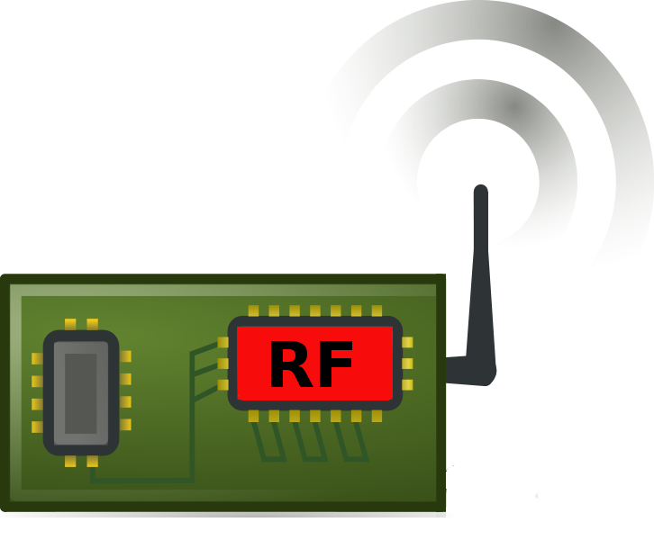
Communication remains a significant challenge
Performing communication remains orders of magnitude more energy expensive than performing sensing and computation
No scaling in power consumption due to Moore’s law. Energy expensive
Component | Power Consumption
Microcontroller (Apollo3) | 100s of µW’s (48 to 192 MHz)
Sensors | Few to tens of µW’s
Transceiver | Tens to Hundreds of mW’s
Power scaled with Moore’s law O(10 uW)
No such scaling O(100 mW)
Digital
(Baseband)
Analog
(RF)
Notes:
++ Due to the following of Moore’s law, we find that the microcontrollers are bridging the gap between sensing and computation. However, we find that communication remains a challenge and the most expensive IoT platforms' operation. Today the transceivers employed to perform communication consumes orders of magnitude higher energy when compared to performing sensing and processing operation.
++ Why are the communication blocks not witnessing such a dramatic decrease in power consumption? To understand this, we investigate the high-level diagram of the communication block. It consists of digital baseband generation circuitry and an analog front end. Due to the following of Moore’s law, digital baseband circuitry is becoming energy efficient. However, we do not witness any such scaling for the analog components. This causes these analog blocks to remain extremely energy expensive, pushing the power consumption for performing transmissions to be tens to hundreds of milliwatts. As an example, radio transceivers such as LoRa consume hundreds of milliwatts of power consumption. This is precisely the reason that present day IoT platforms operate with limited lifetime even on bulky and energy dense batteries.

Slide 25
Let’s look at the battery-life
Notes:
++ Over the past few years, I have designed several backscatter and beyond backscatter systems that precisely overcome these critical challenges that have limited the widespread deployment of backscatter on IoT devices.
++ The research vision that I have pursued and would like to pursue as a faculty member is to enable a massive deployment of IoT devices by bridging the energy asymmetry between sensing, computation and communication blocks by designing novel platforms and communication mechanisms. I am going to describe some of my research contributions next.

Slide 26
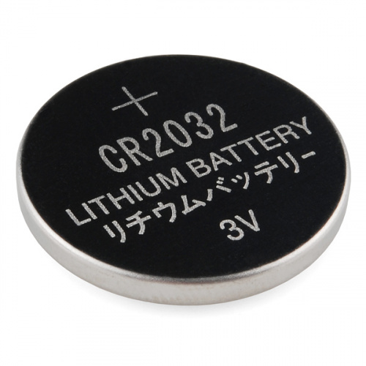
What is the capacity of the battery?
How do we calculate the lifetime of the battery in IoT devices?
We express battery capacity commonly in milliampere-hour (mAH)
Coin cell (CR2032): 240 mAh, Flexible battery (Molex): 10 mAh
How long would battery last under different device load:
Current drawn | Lifetime
240 mA | 1 h
120 mA | 2 h
1 mA | 240 h
Coin cell battery
CR 2032 (240 mAh)

Slide 27
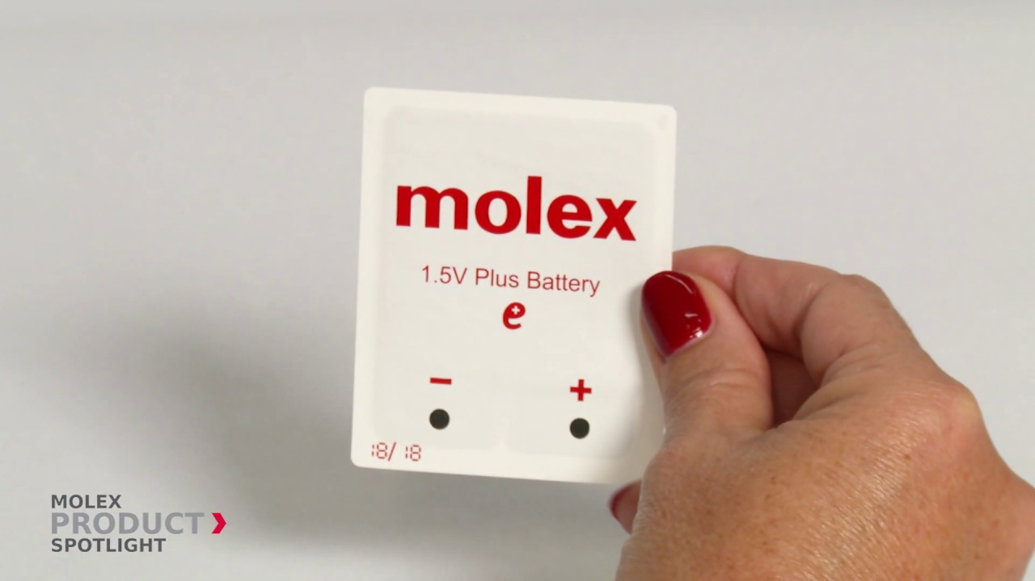
What is the expected lifespan of a battery?
Coin cell (CR2032): 240 mAh, Flexible battery (Molex): 10 mAh
What is the battery life under different device loads:
Coin cell battery
CR 2032 (240 mAh)
Flexible Battery
(10 mAh)
Component | Current draw
Microcontroller | 200 uA
Accelerometer | 10 uA
WiFi Radio | 15 mA
Bluetooth radio | 1 mA

Slide 28
What is the expected lifespan of a battery?
Coin cell (CR2032): 240 mAh, Flexible battery (Molex): 10 mAh
What is the battery life under different device loads:
Coin cell battery
CR 2032 (240 mAh)
Flexible Battery
(10 mAh)
Component | Current draw | Flexible Battery | Coin cell
Microcontroller | 200 uA | 50 h | 1200 h
Accelerometer | 10 uA | 1000 h | 24000
WiFi Radio | 15 mA | 45 mins | 16 h
Bluetooth radio | 1 mA | 10 h | 240 h

Slide 29
Do we replace batteries every week, month, or years?
Notes:
++ Over the past few years, I have designed several backscatter and beyond backscatter systems that precisely overcome these critical challenges that have limited the widespread deployment of backscatter on IoT devices.
++ The research vision that I have pursued and would like to pursue as a faculty member is to enable a massive deployment of IoT devices by bridging the energy asymmetry between sensing, computation and communication blocks by designing novel platforms and communication mechanisms. I am going to describe some of my research contributions next.

Slide 30
Wireless embedded systems has an energy challenge
Notes:
++ While we are deploying an enormously large number of IoT devices, I claim that very little attention is being paid to their energy challenge.
++ Today, most IoT devices are very energy expensive, and consequently, they rely on bulky batteries such as AA/AAA sized batteries for their operation. Even when operating on these batteries, they require frequent replacement of the exhausted batteries. This can be challenging when performed at a massive scale, especially considering that we may have a trillion embedded device deployed in the world.
++ Further, it can also harm the environment. These batteries use toxic chemicals, which means now we can have billions of toxic chemicals laden batteries that would be disposed of in landfills. This is especially important as sustainability has become an essential aspect across the world; in fact, imperial college was celebrating sustainability week.

Slide 31
Backscatter transmissions
Notes:
++ Over the past few years, I have designed several backscatter and beyond backscatter systems that precisely overcome these critical challenges that have limited the widespread deployment of backscatter on IoT devices.
++ The research vision that I have pursued and would like to pursue as a faculty member is to enable a massive deployment of IoT devices by bridging the energy asymmetry between sensing, computation and communication blocks by designing novel platforms and communication mechanisms. I am going to describe some of my research contributions next.

Slide 32
Backscatter transmits at (up to) 10000x lower power consumption than conventional radios
Backscatter through absorption or reflection of ambient wireless signals enables wireless transmissions at microwatts of power consumption
Ambient RF signal
Antenna
Reflected (backscatter) signal
RF Switch
Modulating Signal (Digital)
Backscatter tag
Receiver
Notes:
Backscatter communication actually help us overcome this limitation

Slide 33
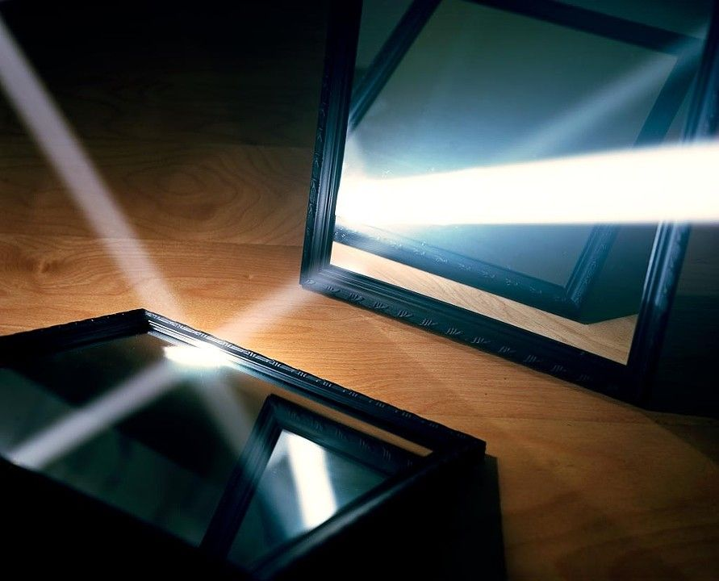
One way to understand backscatter transmissions
Notes:
++ While we are deploying an enormously large number of IoT devices, I claim that very little attention is being paid to their energy challenge.
++ Today, most IoT devices are very energy expensive, and consequently, they rely on bulky batteries such as AA/AAA sized batteries for their operation. Even when operating on these batteries, they require frequent replacement of the exhausted batteries. This can be challenging when performed at a massive scale, especially considering that we may have a trillion embedded device deployed in the world.
++ Further, it can also harm the environment. These batteries use toxic chemicals, which means now we can have billions of toxic chemicals laden batteries that would be disposed of in landfills. This is especially important as sustainability has become an essential aspect across the world; in fact, imperial college was celebrating sustainability week.

Slide 34
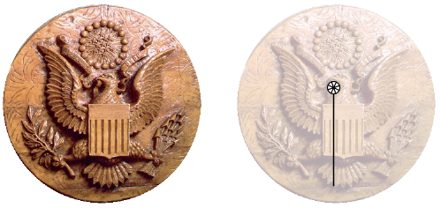
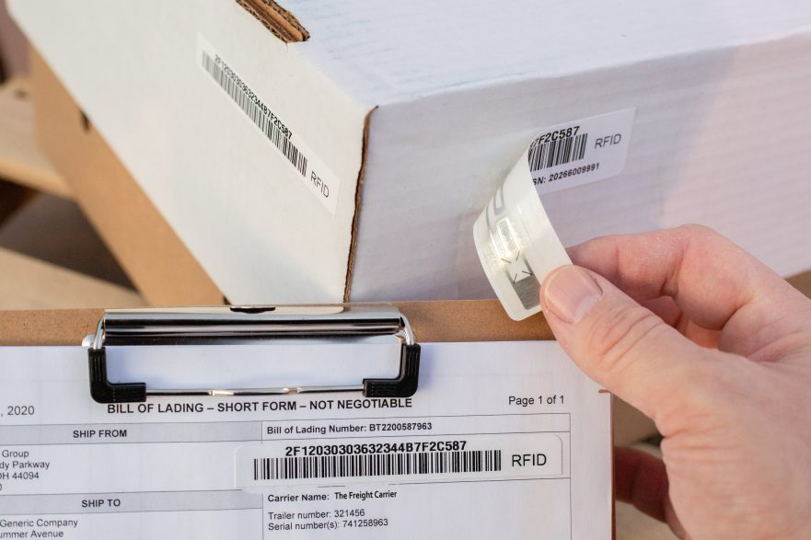

Backscatter is not a new transmission mechanism
First backscatter system: Great seal bug (The Thing) 1945
RFIDs: one of the most widely deployed backscatter system
Great Seal Bug (Backscatter device embedded for spying)
RFID System

Slide 35

Reflecting FM Signals for Transmissions
Courtesy: University of Washington, Seattle
FM Backscatter: Enabling Connected Cities and Smart Fabrics, USENIX NSDI 2017

Slide 36

Reflecting TV Signals for Transmissions
Courtesy: University of Washington, Seattle
Ambient Backscatter: Wireless Communication Out of Thin Air, ACM SIGCOMM 2013

Slide 37

Reflecting WiFi Signals for Transmissions
Courtesy: University of Washington, Seattle

Slide 38
Long range backscatter transmissions using LoRea
LoRea is a long range, low-power, and low-cost backscatter architecture
System Overview
Backscatter Tag Hardware Prototype
(Peak Power of 70 µW)
Varshney et al. ”LoRea: A Backscatter architecture that achieves a long communication range” ACM SENSYS 2017
Notes:
+ Over the past several years, I have designed systems that overcome these critical limitations that have hindered the backscatter systems and have the prevented widespread adoption of the backscatter mechanisms on the Internet of Things devices. One of these systems is LoRea.
+ LoRea was presented at ACM SENSYS, which is a flagship conference in the area of embedded sensor systems. I show the architecture of LoRea on the left-hand figure on the slide. It consists of one or more commodity devices such as a smartphone or Wi-Fi router that provides the necessary carrier signal to support backscatter transmissions, a low-power backscatter tag that I had designed and transmit at a peak power of 70uw, and one or more receiver of backscatter transmissions.
+ The key highlight of LoRea was that it could achieve a significantly larger communication range than existing systems, was designed using off the shelf components and cost (few tens of USDs). Further, the backscatter tag could achieve this capability at orders of magnitude lower energy than commercially available radio transceivers.
+ How did LoRea achieve this capability? We would describe next.

Slide 39


We ran out of space while performing experiments
State-of-art few meters. We achieved kilometers, was difficult to anticipate
Initial experiments conducted near the university and a river in Uppsala
Experiment Setup
Receiving transmissions 1km away from the setup
Notes:
Incorporating these three design elements, allows us to significantly push the communication range of the system. Next, we did experiments to investigate the transmission range that we can support with our system.
Performing these experiments was challenging as when we were designing LoRea the state of the art backscatter systems achieved a communication range of tens of meters. Hence, it was difficult to anticipate space required to perform these experiments.
We conducted the first experiment in the university, and we ran out the space, next we took the experiment setup next to a river in Uppsala. I show the setup on left hand side image, and on the right is picture of me capturing transmissions one kilometer away. However, while we were able to receive transmissions at fairly high SNR, we again ran out of space due to large range that we could achieve.

Slide 40



LoRea achieved the highest demonstrated range
Receive up to a distance of 3.4 kilometers from tag
Highest demonstrated range. Outperforms leading labs/universities
Experiment Setup
(On a small hill)
Receiving backscatter transmissions kilometers away from setup
Experiment setup video
Notes:
Hence, to find the maximum range we could achieve with our system, we took the entire setup outside Uppsala to an open space. We kept the backscatter setup on top of a small hill, and investigated the maximum communication range that we could support.
Performing these experiments was significantly challenging, as we would setup experiment in the daytime, and by the time we would finish collecting the link metrics, it would be dawn. We also had to walk significant distances with equipment.
We found that we could communicate up to a distance of 3.4 km while consuming tens of microwatts of power for wireless transmissions at the backscatter tag. Achieving such high communication range was considered challenging or even infeasible with backscatter mechanism, and LoRea helped overturn notion that backscatter is a low range transmission mechanism.

Slide 41

LoRea bridges the energy asymmetry between communication (TX), sensing and processing
Off-the-shelf hardware for transmission and receptions. Tens of USD
Overturn notion that backscatter is a short-range transmission mechanism
Component | Power Consumption
LoRea (Transmissions) | 70 µW (868 MHz)
Conventional Transceiver | Tens to hundreds of mW’s
Microcontroller (Apollo3) | 100s of µW’s
Sensors | Few to tens of µW’s
LoRea transmits at similar power consumption as a sensor
Texas Instruments CC1310 Launchpad: Receiver
Backscatter Tag Hardware Prototype
(Peak Power of 70 µW)
Notes:
+ Thus, with LoRea, we were able to design a backscatter system that was able to overcome the range and cost limitations that had limited all the existing backscatter system, and had hindered the widespread usage of the mechanism on the IoT devices
.
+ In fact, the backscatter tag even though it was designed using off-the-shelf components is orders of magnitude more efficient than commercial transceivers while supporting orders of magnitude lower power consumption.
+ the entire backscatter setup costs just few tens of USDs, which dramatically lowers the cost of infrastructure required to support the backscatter tags and carrier emitter device.

Slide 42
Let’s look at the battery-life again
Notes:
++ Over the past few years, I have designed several backscatter and beyond backscatter systems that precisely overcome these critical challenges that have limited the widespread deployment of backscatter on IoT devices.
++ The research vision that I have pursued and would like to pursue as a faculty member is to enable a massive deployment of IoT devices by bridging the energy asymmetry between sensing, computation and communication blocks by designing novel platforms and communication mechanisms. I am going to describe some of my research contributions next.

Slide 43
What is the expected lifespan of a battery?
Coin cell (CR2032): 240 mAh, Flexible battery (Molex): 10 mAh
Backscatter transmitter: (LoRea, SENSYS 2017) – 35 uA
Let’s estimate long would battery last under different device load:
Component | Current draw | Flexible Battery | Coin cell
Microcontroller | 200 uA | 50 h | 1200 h
Accelerometer | 10 uA | 1000 h | 24000
WiFi Transmitter | 15 mA | 45 mins | 16 h
Bluetooth Transmitter | 1 mA | 10 h | 240 h
Backscatter Transmitter | 35 uA | 285.7 h | 6857 h

Slide 44
Low power enables even battery-free devices
Notes:
++ Over the past few years, I have designed several backscatter and beyond backscatter systems that precisely overcome these critical challenges that have limited the widespread deployment of backscatter on IoT devices.
++ The research vision that I have pursued and would like to pursue as a faculty member is to enable a massive deployment of IoT devices by bridging the energy asymmetry between sensing, computation and communication blocks by designing novel platforms and communication mechanisms. I am going to describe some of my research contributions next.

Slide 45

What's next? Transmissions on harvested energy
𝜇W
Energy harvester
Microwatts of power available to harvest from ambient sources
Notes:
++ The high-power consumption for the IoT platforms also blocks an important and promising direction to enable the sustainable deployment of large-scale embedded devices. This is to eliminate batteries from these platforms altogether. If we eliminate batteries, how do we power these devices?
++We use the fact that ambient energy sources surround us. We are constantly bombarded with radio frequency transmissions such as television, wifi, radio signals, or we have waste heat energy sources, or the indoor light is ubiquitous. All these sources could be harvested to derive energy to power the IoT devices and platforms and eliminate the overhead associated with batteries on these platforms. However, the challenge that we encounter is that we could only derive microwatts of power from these ambient sources, which is sufficient to power the sensors and microcontrollers. However, we need orders of magnitude higher power for operating radio transceivers such as LoRa. This makes it challenging, if not impossible, to power sensors through energy derived from the environment.

Slide 46

Demo: Gesture recognition
Varshney et al. “Battery-free Visible Light Sensing” ACM VLCS 2017 (Best Paper)
ACM Mobicom 2017 SRC (Graduate winner)

Slide 47

Battery-free Cellphone
Courtesy: University of Washington, Seattle
Battery-free Cellphone, IMWUT/UBICOMP 2018

Slide 48
Wireless communication using Light?
Notes:
++ Over the past few years, I have designed several backscatter and beyond backscatter systems that precisely overcome these critical challenges that have limited the widespread deployment of backscatter on IoT devices.
++ The research vision that I have pursued and would like to pursue as a faculty member is to enable a massive deployment of IoT devices by bridging the energy asymmetry between sensing, computation and communication blocks by designing novel platforms and communication mechanisms. I am going to describe some of my research contributions next.

Slide 49

EDISON : Communication through visible light
Backscatter modulator
LiFi Front-end
MCU
Power management
Galliesto et al. ” Two to tango hybrid light and backscatter networks for next billion devices” ACM MOBISYS 2020
(co-primary author with me)
Notes:
External power management for convenience

Slide 50

Energy flow within the EDISON tag
Notes:
Only power management

Slide 51

Receiving LiFi at µW’s of power consumption
Avoid energy expensive components such as TIAs, ADCs
Solar cell (Photovoltaic mode) with a low-power comparator
LiFi Receiver Schematic
Solar cell response to LiFi transmissions
Enables us to receive LiFi transmissions at a power budget of 20 µW
Notes:
.

Slide 52


Edison: Solved challenges of downlink communication
Backscatter a transmission mechanism, a challenge with the reception
LiFi is complimentary to RF-backscatter. Energy efficient downlink
Collaborated with IMDEA Networks, Spain, to develop EDISON
EDISON LiFi Transmitter
EDISON Tag
Galliesto et al. ” Two to tango hybrid light and backscatter networks for next billion devices” ACM MOBISYS 2020
(co-primary author with me)
Notes:
In order to remove battery-> Energy efficient
We have created an hybrid system: vlc for reception and backscattering for transmission
Move carrier away from device
Reflecting and absorbing

Slide 53








Overview of the Edison system
Lighting Network
0
1100
1
0
0
11
RF Carrier
RF Router
(edge device)
RF Backscatter
Battery-free device
Notes:
obvious

Slide 54
Advanced Topics in Networking 6204: Special Topics in Internet of Things
Networking aspects of wireless embedded systems, Internet of things
Advanced level course for PhD students in related research areas
We meet once a week; Wednesdays – 2 pm to 4 pm;
Course is structured as a hybrid of lectures, seminar and discussions
Course website: https://weiserlab.github.io/ambuj/cs6204, Credits: 4
Office hours: COM3 - #2 – 25, Friday : 4 – 6 pm (drop-in)
Notes:
++ We may all have heard of the term Internet of Things. So how are these wireless embedded systems related to the Internet of Things: Today, IoT includes a broad class of devices, including powerful platforms such as smartphones. However, it also includes more resource-constrained devices and what we call Wireless Embedded Systems, and in fact, I consider it to be one of the essential parts of the IoT ecosystem.
++ These are platforms equipped with a radio transceiver, sensor, microcontroller, and some form of energy storage. These platforms also often form a network, and sensor network as it is called has been an active area of research for the past two decades.
++ The research community has also developed wireless embedded platforms which we may know about, and these include: CMUCAM, which is an image sensor platform developed at Carnegie Mellon University, or Permamote is long life sensor platform from the lab I am associated with at UC Berkeley or Lorea which is a long-range backscatter platform that I had developed as part of my doctoral dissertation at Uppsala University. All of these are an example of Wireless Embedded Systems.

Slide 55
CS 6204 - Advanced Topics in Networking
Ambuj Varshney
ambujv@nus.edu.sg
http://ambuj.se
Notes:
Good morning/afternoon everyone. Thank you for inviting me for giving this talk.
In this talk, I will describe my effort to design ubiquitous Internet of Things systems.
In the end of the talk: I will cover some of the future research directions that I would like to address as a faculty member.

